Slide 1

Building Virtual Labs: CCC edition

Slide 2

Chapter 1: Introductions, Prerequisite Knowledge, Three rules of IT disciplines

Slide 3

Hello There
Tony Robinson/da_667
Security Analyst, Hurricane Labs
I do threat intel, documentation, and NSM things

Slide 4
Purpose of this training
Teach you how to create a VM lab
Red team, Blue team, Purple team, etc. You need a place to practice.
Teach you solid network and system administration practices to make a safe place to practice
Provide you with a starting point, then let you go wild on your own

Slide 5
Prerequisite Knowledge: TCP/IP Networking
Are you familiar with OSI or TCP/IP network models?
Do you know what an IP address is? DNS Servers? DHCP? Default gateway?
Do you know what RFC1918 addresses are, and why they are used? (192.168.0.0/16, 172.16.0.0/12, 10.0.0.0/8)
Do you know how to configure these things on Linux or Windows (e.g. network adapter properties, ifconfig, ip link, ip route, /etc/resolv.conf, etc.)

Slide 6
Prerequisite Knowledge: TCP/IP Networking (Cont’d)
Are you familiar with different transport protocols (e.g. TCP, UDP, ICMP)?
Can you identify what port common TCP/UDP services operate on (e.g. 53/udp = DNS, 80/TCP = HTTP, 123/udp = NTP, 22/TCP = SSH, etc.)
Do you understand how stateful firewalls operate, and what criteria they use for blocking/allowing connections? (IP addresses, protocols, port numbers, ICMP types/codes, etc.)

Slide 7
Prerequisite Knowledge:Operating Systems
Have you ever installed an OS before? Any OS – Windows, Linux/Unix, OSX, etc.
Do you know what an installation ISO is, and how to boot from one?
Are you familiar with the Windows command prompt and/or the Linux/Unix/OSX terminal/CLI?
Have you seen or used any of the following commands: ping, netstat, wget, curl, ipconfig, ifconfig, etc.)
Have you ever used a command line text editor before? (e.g. Vim, nano, emacs, etc.)
Are you familiar with SSH and/or SCP protocols?

Slide 8
Prerequisite knowledge: Virtualization
You’ve probably used a VM at some point, right?
If not, I guess you’re here for a reason

Slide 9
I know all of this. Am I going to be bored in this class?
Maybe a little at first, but making sure all students are on the same page is important
Maybe you’ll learn something new

Slide 10
I don’t know any of this. Am I doomed?
Follow along as best you can
If you miss something/mess up, don’t fret
Leanpub.com/avatar
Free PDF copy of the book this training is based off of
USB drives going around
Free copy of the slides for this training. Use them however you see fit.
Github repo for slide deck (if you’re allergic to thumb drives): https://github.com/da667/Building_Virtual_Machine_Labs-Live_Training

Slide 11
Where can I go if I want to learn more?
Cybrary.it – has a host of different training videos on various subjects
Most are centered around IT certifications, but still extremely valuable
Learn Python The Hard Way – Command-line crash course
https://learnpythonthehardway.org/book/appendixa.html
Can’t go wrong with No Starch Press books
The Linux Command Line
TCP/IP Guide
Network Know-How
Practical Packet Analysis
More resources can be found in Chapter 14

Slide 12
The Three Rules of IT Disciplines
Don’t Panic
Being level-headed in the event of unforeseen problems is extremely important.
Software changes
Features and UI elements may be added, removed, or be relocated.
Consult the documentation
Patch notes, product forums, Help menu, PDFs, product support sites, etc.

Slide 13

Chapter 2: Hypervisors, Virtual Networking, and Hardware Performance

Slide 14
Intro to Virtualization
Virtualization – Taking one physical computer, and splitting its resources into chunks/containers to host smaller, independant computing environments (Virtual Machines, or “VMs”
Think: Computer(s) within a computer
Hypervisor – Software used to create and manage all aspects of VM creation and operation
Baremetal: The hypervisor directly manages physical hardware
Hosted: The hypervisor is installed on top of an existing operating system and uses it to manage physical hardware

Slide 15
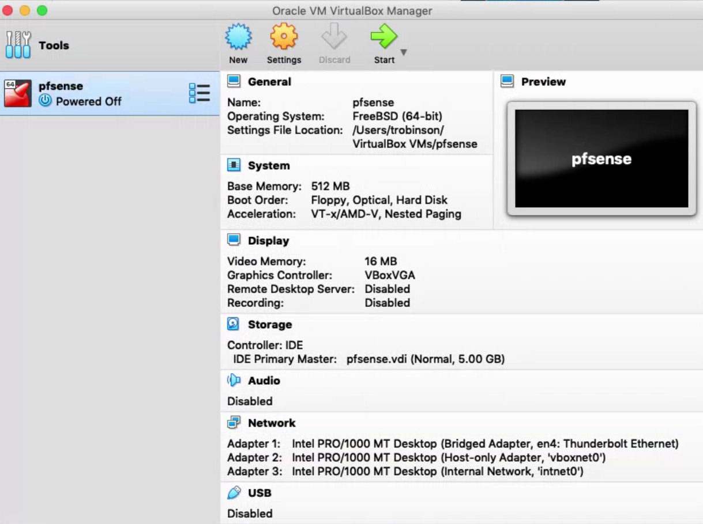

Slide 16
Intro To Virtual Networking
Baremetal Hypervisors – Virtual Switches
Can be uplinked to a physical NIC for outbound connectivity or unlinked to isolate VMs
Hosted Hypervisors – Virtual Network Segments
Host-only: VMs can only communicate with each other VMs on this segment, or the hypervisor host (through a virtual network adapter)
Internal: Variation of host-only network where the host has no network connectivity to VMs in this network segment
NAT: Network Address Translation – Can talk to other VMs on the same network segment. Uses the hypervisor host’s IP address as a NAT provider for outbound network comms
Bridged: VMs on this network segment act as though they are physically connected to the same network as the hypervisor host

Slide 17
Hardware Resources
Virtualization requires RAM, CPU, and Disk Space/IO
A lack of any one of these three things leads to poor host and/or VM performance
Most hypervisors also require specific CPU features
AMD-V / VT-x
Note: Motherboard must also support VT-x or AMD-V
Instructions on how to do this differ by manufacturer
64-bit support

Slide 19

Chapter 3: Network Design and VM resource allocations

Slide 20
Lab VMs and Allocations
pfSense
512MB of RAM
5GB Disk
1 CPU core
SIEM VM
2GB of RAM
60GB Disk
1 CPU core
IPS VM
1-2GB of RAM
40GB Disk
1 CPU core
Kali Linux
2-4GB of RAM
40GB Disk
1 CPU core
Metasploitable 2
512MB of RAM
8GB Disk
1 CPU core

Slide 21
Lab VMs and Allocations (cont’d)
Total Allocations
RAM
Min: 6GB
Optimal: 9GB+
Disk
VM Disks will require at least 160GB of free disk.
Recommend 500GB+ of free space
ISOs, Support Applications, Snapshots, Additional VMs, etc.
Separate disk if possible, SSD if possible
Helps to avoid Disk I/O contetion (but shouldn’t be a big problem)
CPU
Recommend something with 4+ cores
No, hyperthreading does NOT count

Slide 22
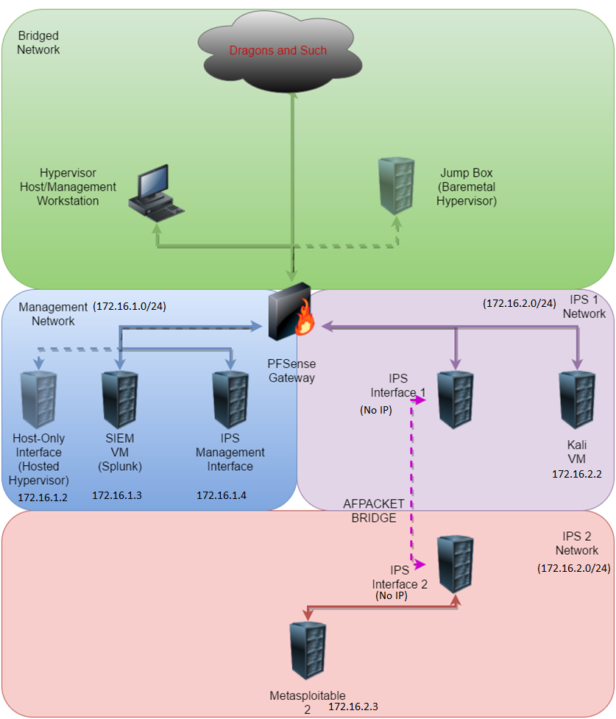

Slide 23

Chapter 4: Preparation

Slide 24
Tools of the trade
Useful software packages for your lab
Installation ISOs (pfSense, Kali, Ubuntu 18.04)
Pre-configured VMs (Metasploitable 2)
Supporting applications (text editors, cli tools, remote access suites, etc.)
Websites to register to (splunk.com, snort.org)
USB drive with the entire suite of tools (Windows, Linux, OSX) being distributed
This chapter is more for your reference at home and if you want to share this training with others

Slide 25
Tools of the Trade – ISOs and VMs
Download the following:
pfSense – FreeBSD based firewall distribution
https://pfsense.org/download/
Select “AMD64” as architecture, “CD Image (ISO) Installer” as Installer, Closest geographical mirror, then click “Download”
Kali Linux – Debian-based penetration testing distribution
https://kali.org/downloads
Locate “Kali Linux 64 bit”, and click on “HTTP”
Ubuntu Server – A stable and easy to use Linux server distribution
https://www.ubuntu.com/download/server
Always select the latest LTS (Long-Term Support) release
Metasploitable 2 – An intentionally vulnerable Linux VM
https://sourceforge.net/projects/metasploitable/files/Metasploitable2/
Select “Download Latest Version” (metasploitable-linux-2.0.0.zip)
Note: you will need a compression tool to unzip and use this VM (covered shortly)

Slide 26
Tools of the Trade – Windows Apps
mRemoteNG – a tabbed front-end for a variety of remote access protocols
https://mremoteng.org/download
WinSCP – a windows client application for the SCP protocol
https://winscp.net/eng/download.php
7-zip – an open-source application that can handle a variety of compressed file formats
https://www.7-zip.org/download.html
puttygen (64-bit) – a windows application for generating SSH keys
https://www.chiark.greenend.org.uk/~sgtatham/putty/latest.html
Notepad++ (64-bit) – a powerful text editor
https://notepad-plus-plus.org/download/
KeePassXC (64-bit) – a multiplatform password manager
https://keepassxc.org/download/#windows

Slide 27
Tools of the Trade – OSX Apps
Native terminal applications (pre-installed):
vi/vim – a very old text editor that is universally available on most UNIX-like operating systems
ssh – a client application that allows to connect secure to remote SSH servers
scp – secure copy protocol client. Allows you to transfer files to/from a remote system utilizing the SSH protocol
ssh-keygen – allows you to generate a public/private key pair. Enables passwordless login, OR two-factor authentication
ssh-copy-id – a pain-free method of copying your public key to a remote SSH server to enable key-based authentication
zip/unzip, gzip/gunzip – command line utilities that allow you to decompress .zip or .gz files
Alias – command line tool that lets you alias entire commands plus their arguments to another name (think: shortcuts)

Slide 28
OSX Apps (cont’d)
Third-party Tools (download and install):
iTerm2 – a better replacement for the OSX terminal application
https://www.iterm2.com/downloads.html
BBEdit – powerful text editor
https://www.barebones.com/products/bbedit/download.html
Note: you do NOT need to pay for the licensed features
KeepassXC – multiplatform password manager
https://keepassxc.org/download/#mac

Slide 29
Tools of the Trade – Linux Apps
Terminal applications (usually installed as ‘core utilities’):
vi/vim – a very old text editor that is universally available on most UNIX-like operating systems
ssh – a client application that allows to connect secure to remote SSH servers
scp – secure copy protocol client. Allows you to transfer files to/from a remote system utilizing the SSH protocol
ssh-keygen – allows you to generate a public/private key pair. Enables passwordless login, OR two-factor authentication
ssh-copy-id – a pain-free method of copying your public key to a remote SSH server to enable key-based authentication
zip/unzip, gzip/gunzip – command line utilities that allow you to decompress .zip or .gz files
alias – command line tool that lets you alias entire commands plus their arguments to another name (think: shortcuts)

Slide 30
Linux Apps (cont’d)
Graphical text editor (if you don’t like vi/vim)
Common editors: gedit, kwrite, leafpad, etc.
A terminal application
Common terminal apps: Konsole, Terminal, Gnome-Terminal
Special Mention: Gnome Terminator – install this if you can.
Very similar to iTerm2
https://gnometerminator.blogspot.com/p/introduction.html
A window manager
I know you’re a leet console cowboy, but I am NOT playing with virtualbox headless.
Common WMs: Gnome, Cinnamon, KDE, flux, XFCE, etc.
KeepassXC – multiplatform password manager
https://keepassxc.org/download/#linux
Recommend using the AppImage installer

Slide 31
Tools of the Trade – Website Registration
Splunk.com
https://www.splunk.com/page/sign_up
Download Splunk Enterprise, Universal Forwarder
Download the Linux 64-bit “.deb” Splunk Enterprise and Universal Forwarder packages
Download Splunk TA for Suricata OR Hurricane Labs Add-On for Unified 2
Splunk TA for Suricata: https://splunkbase.splunk.com/app/2760/
Hurricane Labs Add-On for Unified 2 (Snort): https://splunkbase.splunk.com/app/1858/
Request a developer license
https://splunkbase.splunk.com/develop/
Snort.org
https://snort.org/users/sign_up
Register a free account, log in, record your “oinkcode”

Slide 32

Chapter 5: Installing and Configuring Virtualbox

Slide 33
A quick note before we continue..
I will guide you through the initial installation process on Windows, Linux, and OSX
Most demonstrations will be done using vbox on Windows
Host OS shouldn’t matter terribly much until we do routing and remote access (Chapter 11)

Slide 34
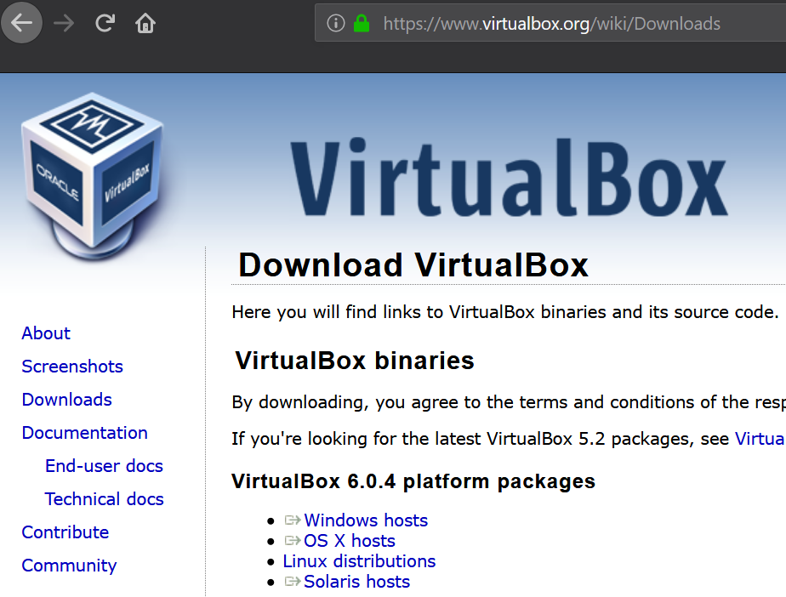
Acquiring the Hypervisor
Acquire the latest Oracle Virtualbox installation package from https://www.virtualbox.org/wiki/Downloads

Slide 35
Installation - Windows
You will need admin access in order to install vbox
Download Windows installer
Double click to begin installer process
If UAC is enabled, click “yes” to allow vbox to install
Notes/Warnings:
you may be prompted to install drivers (USB and/or network), select “yes” to install the virtualbox drivers
Installer warns you that, during installation, network connectivity may be lost temporarily during driver installation
As with most Windows things, you may need to reboot to finish the installation

Slide 36
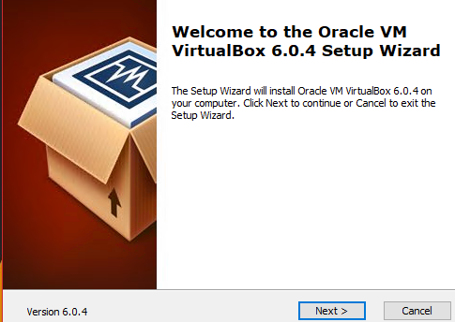
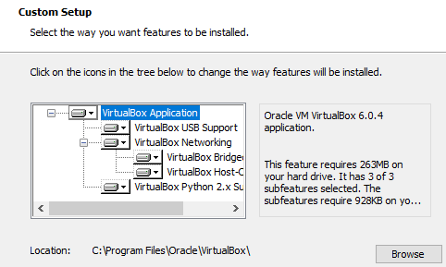
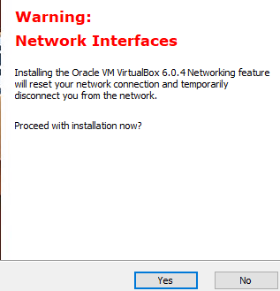
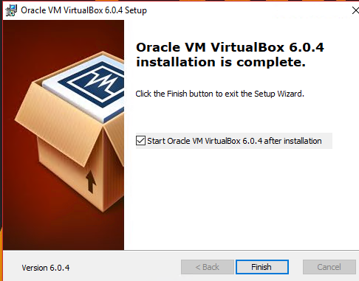
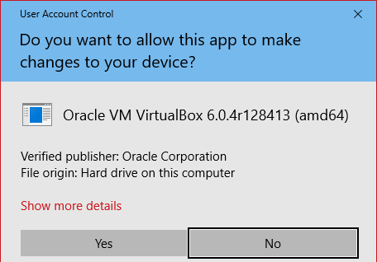
Installation – Windows (cont’d)

Slide 37
Installation - OSX
Download .dmg
Double click to mount/open
Double click .pkg file to start installer
Select “Continue” to the pop-up prompt, then to the vbox installer window
Click “Install”
Enter admin creds
Installation finishes. Click “Close”

Slide 38
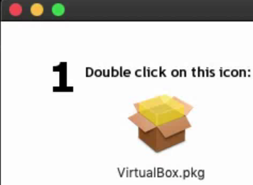
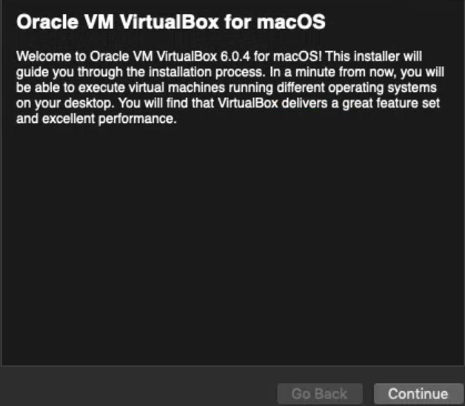
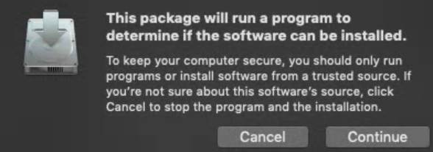
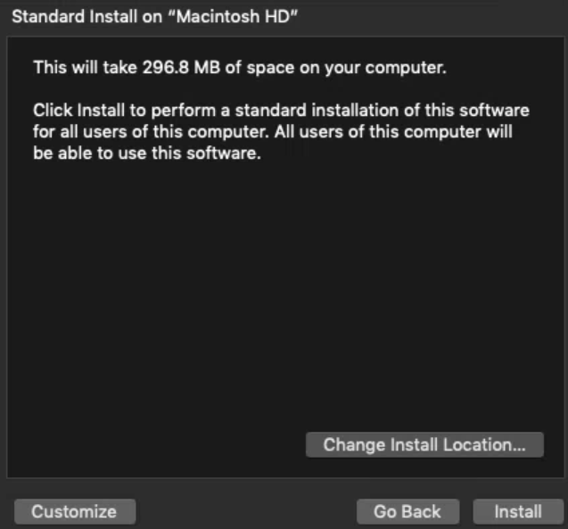
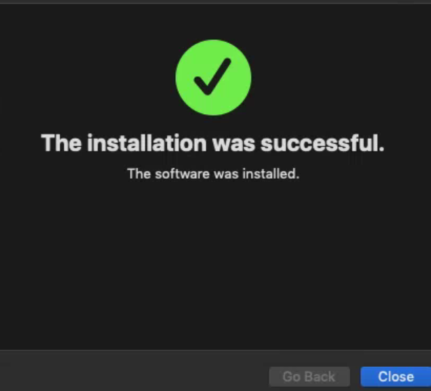
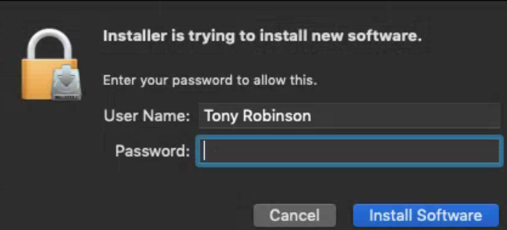
Installation – OSX (cont’d)

Slide 39
Installation - Linux
Download .run package
Download and install linux kernel development headers
Apt distros: apt-get install linux-headers-amd64
Yum distros: yum install kernel-devel
Other distros: read the docs (Sorry, I’m not enough of a nerd for slackware, arch, or gentoo)
Run “chmod u+x Virtualbox-x.x.x-xxxxxx-Linux_amd64.run”
Run (as root, or pre-fixed with “sudo”) ./Virtualbox-x.x.x-xxxxxx-Linux_amd64.run
Installation finishes (installs to /opt/virtualbox)
Virtualbox can be started by running “virtualbox” in a terminal window (or /usr/bin/virtualbox, if your PATH variable isn’t set up with /usr/bin)

Slide 40
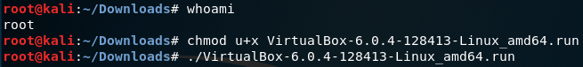
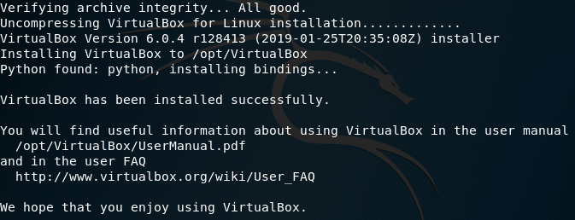
Installation – Linux (cont’d)

Slide 41
Configuring Virtualbox
Configuration tasks:
Set host-only adapter to “Configure Adapter Manually”
Disable host-only network DHCP server
Configure host-only network adapter to utilize IP address 172.16.1.2 with netmask 255.255.255.0
Review Default Machine Folder settings, and reconfigure as necessary

Slide 42
Host-Only Network Interface
By default, virtualbox installs a host-only network interface
Windows: Virtualbox Host-Only Network Adapter
Control Panel > Network and Internet > Network connections (ncpa.cpl)
Network configuration settings will persist beyond reboot
OSX/Linux: vboxnet0
ifconfig (Linux or OSX) or ip (Linux)
Network settings (and the interface itself) will NOT persist between reboots

Slide 43
Accessing the Host Network Manager
Tool that allows you to:
Configure the default host-only adapter
IP Address/Netmask (not reliable)
Enable/Disable/Reconfigure DHCP service for host-only network
Can be accessed from the GUI:
File > Host Network Manager
Tools > Network

Slide 44
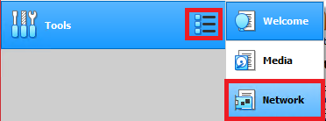
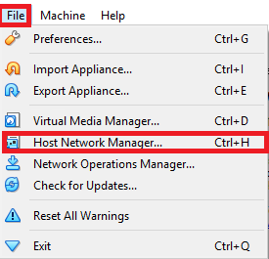
Accessing the Host Network Manager (cont’d)
Method 1:
Method 2:

Slide 45
Tasks to complete
Click Properties, select “Adapter” tab, confirm radio button “Configure Adapter Manually” is selected
Click the “DHCP Server” tab , ensure that “Enable Server” checkbox is unchecked
Click “Apply” if highlighted

Slide 46
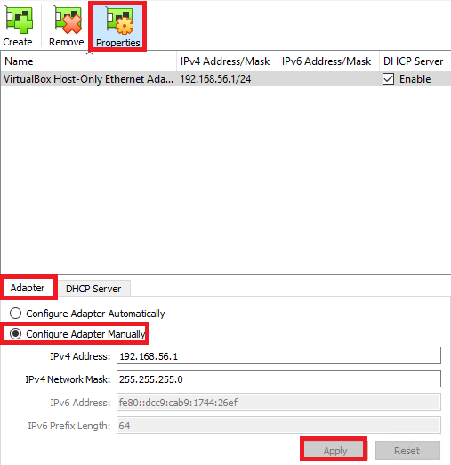
Task 1

Slide 47
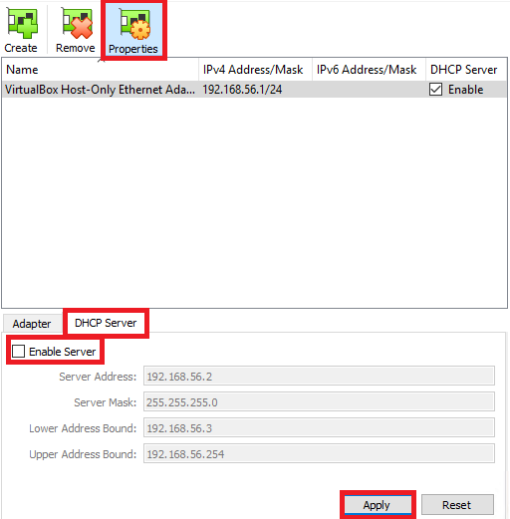
Task 2

Slide 48
Setting IP address and netmask for host-only adapter
Can be done through the Host Network Manager, but its unreliable garbage
The IP address settings don’t stick on Linux and OSX hosts.
Recommended method: utilize native tools to configure the host-only network adapter
Windows: ncpa.cpl
Linux/OSX: ifconfig

Slide 49
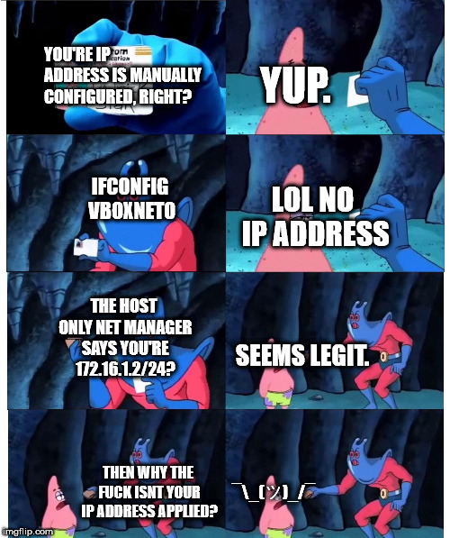

Slide 50
Configure IP address: Windows
Windows Key + R (run prompt) > ncpa.cpl
Virtualbox Host-Only Network Adapter > right click > properties
Disable:
Client for Microsoft Networks
File and Printer Sharing for Microsoft Networks
QoS Packet Scheduler
Microsoft LLDP Protocol Driver
Internet Protocol Version 6 (optional)
Link-Layer Toplogy Discovery Responder
Link-Layer Topology Discovery Mapper I/O Driver

Slide 51
Configure IP address: Windows (cont’d)
Highlight “Internet Protocol Version 4 (TCP/IPv4)” then click “Properties”
Select the “Use the following IP address:” radio button
Enter 172.16.1.2 in the input box labeled “IP Address:”
Enter 255.255.255.0 in the input box labeled “Subnet mask:”
Leave the “Default gateway:”, “Preferred DNS server:”, and “Alternate DNS server:” blank
Click “Advanced”
Click on the “WINS” tab
Click the “Disable NetBIOS over TCP/IP” radio button, then click OK
Click OK on the “Internet Protocol Version 4 (TCP/IPv4) Properties” window
Click OK on the “Virtualbox Host-Only Network Adapter Properties” window

Slide 52
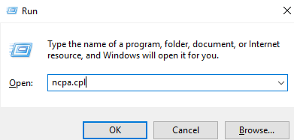
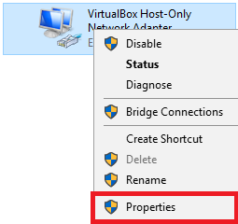
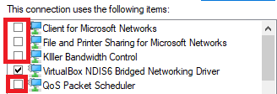
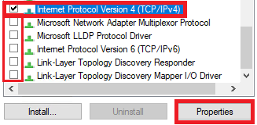
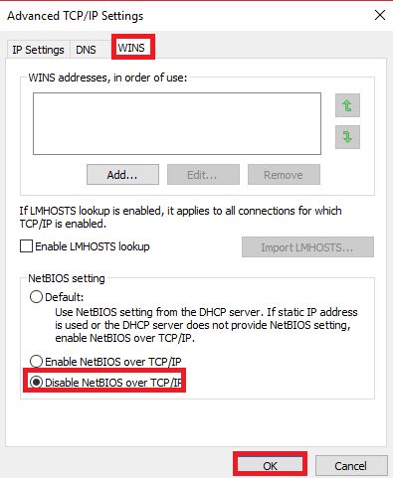
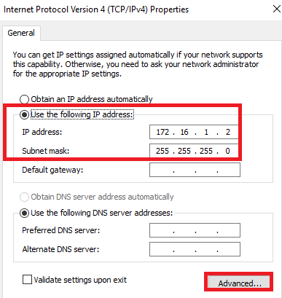
Configure IP address: Windows (cont’d)

Slide 53
Configure IP address: OSX
Open Terminal (or iTerm2, if you installed it)
Default Terminal location: Applications > Utilities > Terminal
Open virtualbox/ensure virtual box is running
sudo ifconfig vboxnet0 172.16.1.2 netmask 255.255.255.0
Note: requires Administrator privileges
ifconfig vboxnet0 to confirm your configuration changes

Slide 54
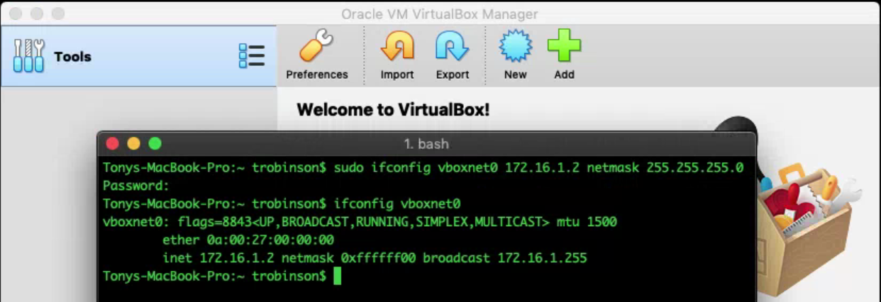
Configure IP address: OSX (cont’d)

Slide 55
Configure IP address: Linux
Open your Terminal app of choice
Ensure virtualbox is running
ifconfig vboxnet0 172.16.1.2 netmask 255.255.255.0
Add “sudo” for non-root users
sudo ifconfig vboxnet0 172.16.1.2 netmask 255.255.255.0
ifconfig vboxnet0 to verify results
Note: some distros don’t ship with ifconfig
ip command is considered the new hotness.
Recommendations:
Install package(s) required to use ifconfig (other portions of the lab utilize it)
[sudo] ip addr add 172.16.1.2/24 dev vboxnet0
[sudo] ip link set up dev vboxnet0
ip addr show vboxnet0 to verify results

Slide 56
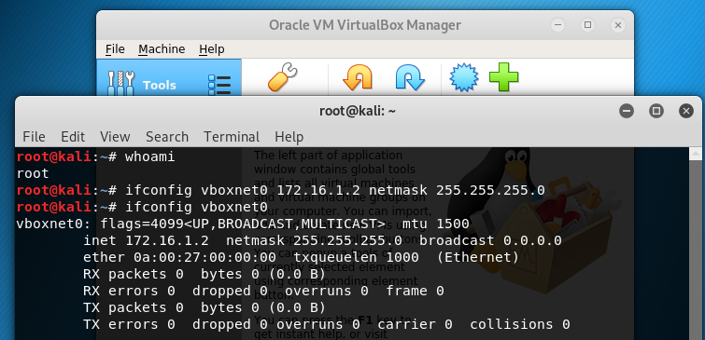
Configure IP address: Linux

Slide 57
Setting the Default Machine Folder (and other vbox settings)
The Preferences menu can be used to modify a host of virtualbox behaviors, and are divided into subcategories:
General
Input
Update
Language
Display
Network
Extensions
Proxy

Slide 58
Setting the Default Machine Folder (and other vbox settings) (cont’d)
We’re interested in the “General” sub-menu.
To access vbox preferences you can:
Click the preferences icon from the virtualbox manager window
Click File > Preferences...
OSX: Virtualbox > Preferences...

Slide 59
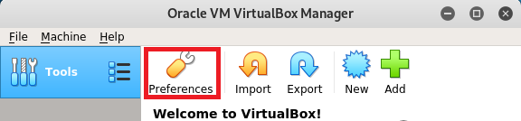
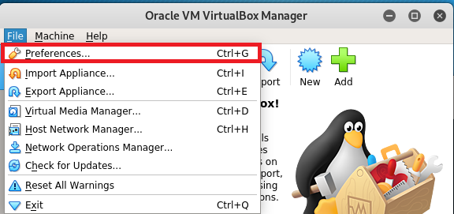
Setting the Default Machine Folder (and other vbox settings) (cont’d)
Option 1:
Option 2:

Slide 60
Setting the Default Machine Folder
Select “General” (should be selected by default)
Default Machine Folder input box
Defines what folder/drive VM files are stored in by default
Click drop-down, select “Other...” and navigate to where you want your VMs stored

Slide 61
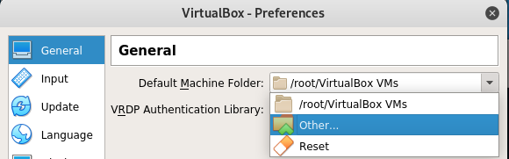
Setting the Default Machine Folder (cont’d)

Slide 62

Chapter 6: Creating and Configuring our first VM, pfSense

Slide 63
Decompress the ISO
Need to decompress the pfsense ISO
ISO is gzipped
Windows: Use 7-zip
Right Click pfSense-CE-x.x.x-RELEASE-px-amd64.iso.gz -> “Extract Here”
Linux/OSX:
Option 1: Utilize your window manager’s filemanager and unzip the file with it
Linux: YMMV
OSX: Double click pfSense-CE-x.x.x-RELEASE-px-amd64.iso.gz
Automatically decompresses gz file.
Option 2: gunzip/gzip –d
Open terminal
cd /path/to/ISO
gunzip pfSense-CE-x.x.x-RELEASE-px-amd64.iso.gz
gzip –d pfSense-CE-x.x.x-RELEASE-px-amd64.iso.gz
Note: gzip –d/gunzip will delete the original gz file after decompressing it

Slide 64
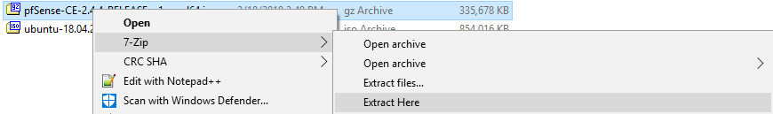
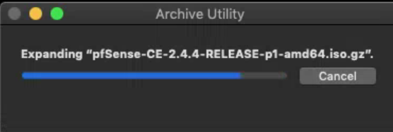
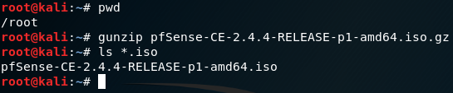
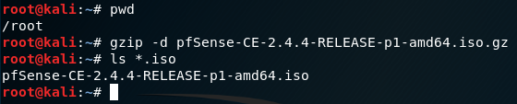
Decompress the ISO cont’d

Slide 65
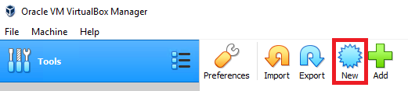
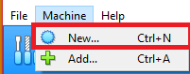
Creating a new VM
Two options:
Click the New icon on the vbox GUI
Click Machine > New...

Slide 66
Create Virtual Machine Wizard:
Screen 1:
Name: pfSense
Machine Folder: Default
Type: BSD
Version FreeBSD (64-bit)
Screen 2:
Memory size: 512MB
Screen 3:
Create virtual hard disk now
Screen 4:
VDI (VirtualBox Disk Image)
Screen 5:
Fixed size
Screen 6:
Name: Pfsense
Size: 5.00GB

Slide 67
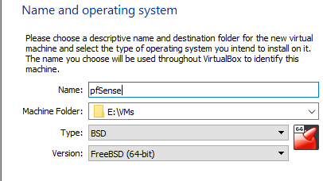
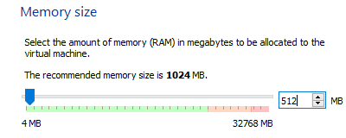
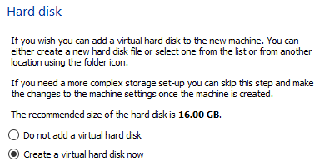
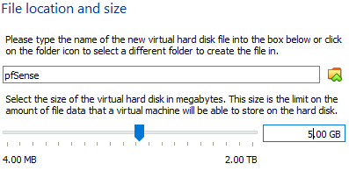
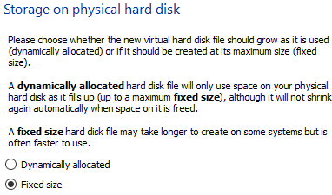
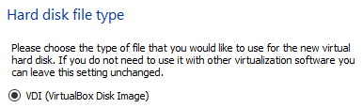
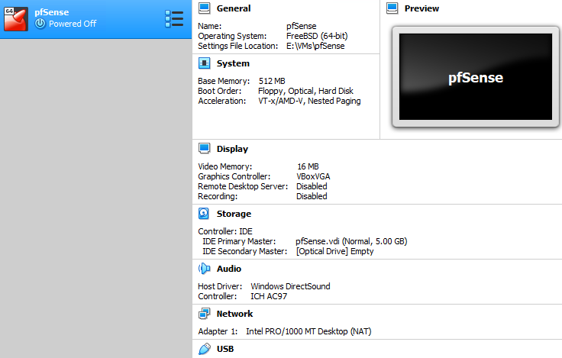
Create Virtual Machine Wizard (cont’d):

Slide 68
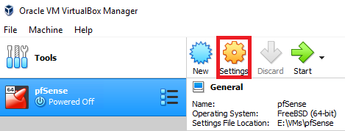
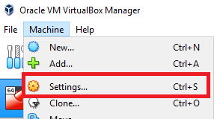
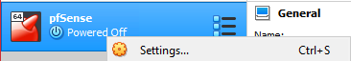
Customizing VM settings
Access the VM settings menu
Right click VM > Settings...
Highlight VM > Machine >Settings...
Highlight VM > click Settings gear icon

Slide 69
Change the following settings
Audio:
Uncheck “Enable Audio”
USB:
Uncheck “Enable USB”
Note for OSX: Ports → USB
Shared Folders
Verify there are NO shared folders specified
Serial Ports:
Verify “Enable Serial Port” is unchecked for Port 1, Port2, Port 3, and Port 4

Slide 70
Change the following settings (cont’d)
Network:
Adapter 1 Tab:
Verify “Enable Network Adapter” is checked
Attached to: Bridged Adapter
Name: Select network card on host OS you use for connecting to the LAN/Internet
Click “Advanced” Drop-down
Adapter Type: Intel PRO/1000 MT Server (82545EM)
MAC Address: copy the contents of this field to a text file, notebook, along with the network it is attached to and VM it belongs to (important for later)
Adapter 2 Tab:
Verify “Enable Network Adapter” is checked
Attached to: Host-Only Adapter
Advanced:
Adapter Type: Intel PRO/1000 MT Server (82545EM)
MAC Address: Same as Adapter 1, Copy the contents, network and VM this corresponds to
Adapter 3 Tab:
Verify “Enable Network Adapter” is checked
Attached to: Internal Network
Name: intnet
Advanced:
Adapter Type: Intel PRO/1000 MT Server (82545EM)
MAC Address: Same as Adapter 1, Copy the contents, network and VM this corresponds to

Slide 71
Change the following settings (cont’d)
Storage:
Click on “Empty” under “Storage Devices”
Click on CD/DVD icon next to the “Optical Drive:” drop-down under “Attributes”
Select “Choose Virtual Optical Disk File, browser to decompressed pfSense ISO, then click “OK”
Note: this will apply the settings from the other “Change the following settings” slides

Slide 72
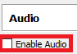
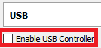






Change the following settings (cont’d)

Slide 73
Installing the OS
Click that big green start button
Be sure to select “Normal Start”
Console window will appear
Note: Clicking this window “attaches” your keyboard/mouse to the VM. “Host Key Combination” gives the keyboard/mouse back to the host OS:
Windows/Linux: Right ctrl
OSX: Left meta (that weird clover thing)
Key can be changed in Preferences > Input > Virtual Machine >Host Key Combination

Slide 74
Installing the OS (cont’d)
Should boot to the pfSense Installer
Select Install
Select your keymap (Default: US)
Select your partioning setup (Auto (UFS) Guided Disk Setup)
Select No on “Manual Configuration” screen (hit tab key)
Select “Reboot” on “Complete screen (hit enter)
After system reboots, (probably into the pfSense installer), close the VM console. When prompted, select “Power off the machine”.

Slide 75





Installing the OS (cont’d)

Slide 76




Installing the OS (cont’d)

Slide 77
Few more settings to mess with...
Navigate back to the pfSense VM settings and perform the following actions:
Navigate to “Storage”
Remove the pfSense ISO and Virtual CD drive located under Storage Devices (should be second entry, under “Controller: IDE”, right below “pfSense.vdi”)
Navigate to “System”
Under the “Motherboard” tab, uncheck all boot options EXCEPT for “Hard Disk”
Verify that “Pointing Device:” is set to “PS/2 Mouse”
Click “OK” to apply settings for both Storage, and System, and exit the pfSense VM Settings menu

Slide 78




Few more settings to mess with... (cont’d)

Slide 79
Why Bother?
Information security discipline “attack surface reduction”
TL;DR: If you aren’t going to use it, disable or remove it
Make yourself a harder target

Slide 80
pfSense: Initial setup (CLI)
Perform initial pfSense configuration tasks:
Map virtual network interfaces, network segments they are assigned to (bridged, host-only, intnet), to pfsense network interfaces (e.g. em0, em1, em2) to pfSense network interfaces (WAN, LAN, OPT1)
Assign IP addresses to WAN, LAN and OPT1 interfaces
Configure DHCP service and scopes for LAN and OPT1 interfaces
Perform some basic connectivity checks (ping, nslookup, curl) to verify basic net connectivity

Slide 81
pfSense Initial setup: Assign Interfaces
Select option 1 on the command line menu, “Assign Interfaces”
Select “n” to should VLANs be set up now?
Assign the WAN, LAN, and OPT1 interfaces to em0, em1, and em2
WAN = Bridged virtual nic
LAN = Host-only virtual nic
OPT1 = intnet virtual nic
Tip: Use the MAC address to figure out which network maps to what network segment.

Slide 82


This right here is why you record the MAC addresses of your VMs

Slide 83
pfSense Initial setup: Set Interface(s) IP address
Select option 2 on the command line menu, “Set Interface(s) IP address”
We will be doing this twice, once for the “LAN” interface, and once for the “OPT1” interface
Lan Interface:
IPv4 Address: 172.16.1.1
Netmask: 24 (255.255.255.0)
Do NOT set an IPv4 upstream gateway address (just hit enter)
Do NOT set up IPv6 (just hit enter)
Do you want to set up DHCP server on LAN? (yes)
Start address: 172.16.1.10
End address: 172.16.1.254
Do NOT reset the webconfigurator to HTTP (ever)
OPT1 Interface:
IPv4 Address: 172.16.2.1
Netmask: 24
Do NOT set an IPv4 upstream gateway address (just hit enter)
Do NOT set up IPv6 (just hit enter)
Do you want to set up DHCP server on OPT1? (yes)
Start address: 172.16.2.10
End address: 172.16.2.254
Do NOT reset the webconfigurator to HTTP (ever)

Slide 84





pfSense Initial setup: Set Interface(s) IP address (cont’d)

Slide 85
pfSense Initial setup: Connectivity checks
Select option 8 “Shell”
Opens a bourne shell on the firewall
Usefull for troubleshooting the underlying OS
Run the following commands:
ping –c4 www.google.com
Why: ICMP connectivity check. Can we resolve a host on the internet, and get ICMP ECHO request/replies?
nslookup www.google.com
Why: DNS check. Verify that we are able to resolve hostnames
curl –i www.google.com
Why: HTTP/HTTPS connectivity check. Can we interact with a remote system on the internet over port 80 (http) or port 443 (https)?

Slide 86



pfSense Initial setup: Connectivity checks (cont’d)

Slide 87
Help! My network checks aren’t working
If you’re here at CCC with me...
Remember that this is a conference network
There are hackers on this network spamming deauths and doing who the hell knows what else
We have to share this pipe with hundreds of other nerds downloading who knows what (300+ MB Metasploit framework updates, etc.)

Slide 88
Help! My network checks aren’t working (cont’d)
Now that your expectations are lowered (or for those of you at home)...
Are you familiar with the OSI or TCP/IP network models? (Don’t worry if you have no idea what this is)
Start low (physical connectivity) and work your way up (MAC Addressing, IP address configs, etc.)
Is your network cable plugged in? Are you connected to the wi-fi network?
Is the WAN interface acquiring an IP address automatically?
It should be getting one via DHCP from your local network
It should also be getting its default gateway and DNS server(s) from this DHCP server
Did you assign the WAN interface to the correct virtualbox network interface?
You need to match the MAC address of the virtualbox bridged network adapter to the correct pfsense network interface (e.g. emX), and assign that interface as the WAN interface

Slide 89
Help! My network checks aren’t working (cont’d)
Your local network may be restricting your connectivity
Some networks do MAC address filtering and/or port security
Talk to your system or network admins about getting approval for your lab environment
Try switching the bridged network adapter in virtualbox to “NAT”
Remember that NAT mode uses the hypervisor host’s IP address and network settings to communicate with external networks.
Check your SOHO router/firewall to ensure there aren’t firewall rules blocking your connectivity checks
Need to allow ICMP echo request outbound, and echo reply inbound for ping to work
Need to allow port 53/udp outbound for nslookup to work
Need to allow port 80/tcp and port 443/tcp outbound for HTTP/HTTPS connectivity (curl checks, software updates, etc.)
This shouldn’t be a problem on your network at home. Most SOHO/ISP routers allow practically anything outbound

Slide 90
Remember these connectivity check commands
We’ll be using the same connectivity checks (ping -c 4, nslookup, curl –I) to ensure the SIEM, IPS, and Kali VMs can all achieve outbound connectivity
Note: We will be hardening network access in a later chapter
This will affect your abilit to use ping (ICMP)
Unless you create a firewall rule to explicitly allow it

Slide 91
Accessing the pfsense WebConfigurator
Remember this earlier?
Remember when we set the host-only network interface on (Linux/OSX/Windows) manually to 172.16.1.2/24?
Open your favorite web browser and point it to https://172.16.1.1
The default username and password for the webConfigurator is: username: admin password: pfsense
Don’t worry, you’ll be changing this in a minute
Note: the web interface uses a self-signed SSL cert. Modern browsers are paranoid and will tell you this is pure evil. You may need to create exceptions for 172.16.1.1 and/or choose “accept and continue” in order to log in.

Slide 92

Accessing the pfsense WebConfigurator (cont’d)

Slide 93

WebConfigurator first-time setup wizard
Upon login, you’ll be required to go through a first-time setup assistant.
As always, hit next to ignore the wall of text.
You can click next on the next page as well (step 1 of 9)

Slide 94
WebConfigurator first-time setup wizard (cont’d)
Step 2 of 9 – General Information
Set the hostname and domain suffix
The defaults of “pfSense” and “localdomain” are fine
Primary/Secondary DNS Server
If you want pfSense to recurse to particular DNS servers (e.g. Cloudflare (1.1.1.1), Quad 9 (9.9.9.9), Google (8.8.8.8, 8.8.4.4) or your ISP’s DNS servers, enter them here.
Override DNS
If checked (recommended): Whatever DNS server DHCP tells the WAN interface to use will be what your lab uses for DNS resolution
If unchecked: Whatever DNS server(s) you enter here (or on the general page) will be the DNS servers used for DNS resolution in your lab
Network troubleshooting tip: Some ISPS (and corporate networks) require you to use only their DNS servers for hostname resolution. Keep this in mind, if DNS isn’t working in your lab environment

Slide 95

WebConfigurator first-time setup wizard (cont’d)

Slide 96

WebConfigurator first-time setup wizard (cont’d)
Step 3 of 9 – Time Server Information
Leave both settings (Time Server Hostname and Timezone) default (click Next)

Slide 97

WebConfigurator first-time setup wizard (cont’d)
Step 4 of 9 – Configure WAN Interface
This page contains a bunch of other configuration options (E.g. MTU, MSS, DHCP hostname, PPTP and/or PPPoE credentials, etc.)
You would know better than I would if you need to change these things for your home/office network
Ensure SelectedType drop-down is set to DHCP. Leave all other settings default. Click Next

Slide 98

WebConfigurator first-time setup wizard (cont’d)
Step 5 of 9 – Configure LAN Interface
Verify LAN IP Address is 172.16.1.1, and Subnet Mask is 24. Click Next

Slide 99
WebConfigurator first-time setup wizard (cont’d)
Step 6 of 9 – Set Admin WebGUI Password
You’ll need to change the default password.
If you haven’t done so already, open up Keepass2 or KeepassXC, create a password database, create an entry for the webConfigurator, then click Next

Slide 100




WebConfigurator first-time setup wizard (cont’d)

Slide 101


WebConfigurator first-time setup wizard (cont’d)

Slide 102


WebConfigurator first-time setup wizard (cont’d)

Slide 103
WebConfigurator first-time setup wizard (cont’d)
Steps 7,8 of 9 – Reload configuration
Click the Reload button to apply your changes (including the new admin password)
Step 9 of 9 – Wizard completed
Click the “Check for updates” button (recommended) or click “Finish” to be redirected to the Dashboard

Slide 104

WebConfigurator first-time setup wizard (cont’d)

Slide 105


Checking for updates
Click “Check for updates” from the Webconfigurator first-time setup wizard
OR on the Dashboard, under System Information, check the Version field.
OR Select System > Update in the drop-down menu

Slide 106

Checking for updates (cont’d)
On the System Update page:
Ensure “Latest stable version” is selected
Click Confirm
Note: will cause the VM to reboot. Log back in, and the update(s) should be applied.

Slide 107

Checking for updates (cont’d)

Slide 108
A few more things to do
System > General Setup
Change to the dark theme (your eyes will thank you)
Set up additional DNS resolvers (optional)
System > Package Manager
Install and enable the Squid proxy service
Firewall > Rules
(Temporary) allow any/any rules to set up our VMs
Snapshots
Revert your VM, in case you make mistakes

Slide 109
System > General Setup
DNS Server Settings
You can specify additional DNS servers here and/or DNS Server Override settings
webConfigurator
Select “pfSense dark” from the Theme drop-down
Note: Theme will not change until after you click Save AND navigate away from this page
Be sure to click Save on the bottom of the page for your settings to apply

Slide 110


System > General Setup (cont’d)

Slide 111
System > Package Manager
Click on Available Packages, search for squid and install the package named “squid”
Not squidGuard, not Lightsquid, just squid.
Just like the system update, click confirm, and let pfSense do its thing.

Slide 112


System > Package Manager

Slide 113
Services > Squid Proxy Server
Menu option appears after squid is installed
Need to change things on the “General” and “Local Cache” tabs
Local Cache:
Scroll to the bottom of the tab and click Save
Why: Squid service demands you to set the Local Cache policy in order to run
General tab:
Under Squid General Settings:
Check Enable Squid Proxy
Change Proxy Interface(s) to LAN and OPT1
Under Headers Handling, Language and other Customizations:
Set X-Forwarded Header Mode drop-down to off
Check “Disable VIA Header”
Check “Suppress Squid Version”
Why: Deception
Click Save when you have made these changes

Slide 114


Services > Squid Proxy Server (cont’d)

Slide 115
Firewall > Rules
Navigate to the LAN tab:
Delete “Default allow LAN IPv6 to any rule (click the trashcan Action icon)
Add Allow rule for IPv4 TCP src: 172.16.1.2 dst: 172.16.1.1 port: 443 (HTTPS) description: better anti-lockout rule
If necessary, re-arrange rule to where it sits just below the rule labeled “Anti-Lockout Rule”
Navigate to OPT1 tab:
Create IPv4 deny src 172.16.2.2 dst:any protocol: any
Metasploitable2 should never be allowed to talk to ANYTHING outside of our lab
Create IPv4 allow any src/dst, any protocol
Place this BELOW the deny rule
Apply your firewall rule changes
Note: If you had to rearrange any rules, click Save to save the rule order, before applying your changes.
Delete “Anti-Lockout Rule” (back on LAN tab)
Click the gear, click the checkbox next to “Anti-lockout” on System > Advanced > Admin Access, click Save
Naviate to Firewall > Rules > LAN, MAKE ABSOLUTELY SURE “better anti-lockout rule” is the first rule on the top

Slide 116


Firewall > Rules (cont’d)

Slide 117


Firewall > Rules (cont’d)

Slide 118

Firewall > Rules (cont’d)

Slide 119

Firewall > Rules (cont’d)

Slide 120


Firewall > Rules (cont’d)

Slide 121
Snapshots
TL;DR: capture the status of a VM in a particular point in time
Why: Can be used to revert (undo) recent changes
Bad configuration change/change management
Malware analysis
Virtualbox manager > Bullet List Icon > Snapshots
Enter a snap shot name, brief description, and click Take

Slide 122



Snapshots (cont’d)

Slide 123
Snapshots (cont’d)
Snapshots are NOT backups
Snapshots are NOT a substitute for backups
EVER.
To restore a snapshot:
Power off your VM
Navigate to snapshots
Select your snapshot
Click “restore”
Don’t need a snapshot? Delete it.
Keep at least one known good snapshot per VM
Use descriptive names, and make use of the notes field so you know what the hell it is you are restoring to
Keep your snapshots up to date
Nothing sucks more than restore a snapshot and finding out you have gigabytes of updates to apply, and a reboot to do before you can get anything done.

Slide 124



Snapshots (cont’d)

Slide 125

Chapter 7: The SIEM VM

Slide 126
SIEM
Security Information and Event Management
This is going to be our system that hosts IDS/IPS logs
OS: Ubuntu Server 18.04
SIEM software: Splunk Enterprise

Slide 127
Tasks to Perform
Create SIEM VM
Create static DHCP mapping on pfSense LAN network
Strip away excess virtual hardware
Install Ubuntu 18.04
Strip remaining excess virtual hardware
Perform connectivity checks
Update VM
Take baseline snapshot

Slide 128
Create Virtual Machine Wizard:
Screen 1:
Name: SIEM
Machine Folder: Default
Type: Linux
Version: Ubuntu (64-bit)
Screen 2:
Memory size: 2GB
Screen 3:
Create virtual hard disk now
Screen 4:
VDI (VirtualBox Disk Image)
Screen 5:
Fixed size
Screen 6:
Name: SIEM
Size: 60.00GB

Slide 129




Create Virtual Machine Wizard (cont’d)

Slide 130
Strip away excess virtual hardware
System:
Set Pointing Device drop-down to PS/2 Mouse
Storage: Choose Virtual Optical Disk file
Ubuntu-18.04.X-live-server-amd64.iso
Audio: Uncheck Enable Audio
Its PulseAudio and doesn’t work half the time, anyhow.
Network: Verify Enable Network Adapter checkbox is checked for Adapter 1 ONLY
Attached to: Host-only Adapter
Advanced Settings
Adapter Type: Intel PRO/1000 MT Server (82545EM)
Copy the MAC Address to your MAC address text file/document
Ensure Cable Connected is checked

Slide 131
Strip away excess virtual hardware (cont’d)
Serial Ports
Ensure no serial ports are enabled (should be default)
USB: Uncheck Enable USB Controller
Shared Folders
Ensure no shared folders are configured (should be default)

Slide 132






Strip away excess virtual hardware (cont’d)

Slide 133
Creating a Static DHCP Mapping
Log in to pfSense webConfigurator (https://172.16.1.1)
Navigate to Services > DHCP Server
Select LAN tab
Scroll all the way to the bottom of the page
DHCP Static Mappings for this Interface
Click Add
Input the MAC address for the SIEM VM
With the colon symbol (:) every two characters
Input 172.16.1.3 for the IP Address
Optional: Enter “SIEM” as the hostname and/or enter a description
Scroll to the bottom of the page, and click Save
Back on the previous page, click Apply Changes
Confirm the new DHCP Static Mapping, by scrolling to the bottom of the page

Slide 134






Creating a Static DHCP Mapping (cont’d)

Slide 135
Creating a Static DHCP Mapping
Remember how to do this
We’ll be doing it again at least 3 more times
LAN: SIEM (you are here), IPS
OPT1: Kali, Metasploitable2
Why: pfSense Static DHCP Mappings ensure VMs get the same IP address
Consistent network access
Without having to statically configure IP addresses
Or use vbox’s (terrible) DHCP server.

Slide 136
Installing Ubuntu 18.04
Install process (Note: arrow keys to move, space bar to select things, Enter to confirm your selections):
Start the VM
Choose English as the preferred language
Select English (US) as the Layout and Variant for your keyboard (selected by default)
Select Install Ubuntu
Confirm network connection settings (Verify MAC address of SIEM VM, confirm IP address of 172.16.1.3/24)

Slide 137
Installing Ubuntu 18.04 (cont’d)
Set http://172.16.1.1:3128 on the configure proxy page
Note: If you fail to do this, its okay! Check out: https://askubuntu.com/questions/257290/configure-proxy-for-apt
TL;DR: as root, create /etc/apt/apt.conf and enter:
Acquire::http::Proxy “http://172.16.1.1:3128”;
Hit enter on the next screen to use the default Ubuntu archive mirror

Slide 138
Installing Ubuntu 18.04 (cont’d)
On Filesystem setup, select Use an Entire Disk
Hit Enter to Choose the disk to install to (the only disk available)
Select Done to begin formatting the disk
Fill out the Profile setup screen
Your Name
Server name (optional)
Username
Password
Note: Be sure to enter the username and password into your password manager

Slide 139
Installing Ubuntu 18.04 (cont’d)
Install OpenSSH server (hit spacebar) then use the arrow keys to select Done, then hit Enter
On Featured Server Snaps, hit tab to highlight Done and hit enter
We don’t need to install anything here
After the installation process completes and Reboot Now is highlighted, close the virtual machine console to shut down the VM

Slide 140


Installing Ubuntu 18.04 (cont’d)

Slide 141


Installing Ubuntu 18.04 (cont’d)

Slide 142

Installing Ubuntu 18.04 (cont’d)

Slide 143

Installing Ubuntu 18.04 (cont’d)

Slide 144


Installing Ubuntu 18.04 (cont’d)

Slide 145

Installing Ubuntu 18.04 (cont’d)

Slide 146


Installing Ubuntu 18.04 (cont’d)

Slide 147

Installing Ubuntu 18.04 (cont’d)

Slide 148

Installing Ubuntu 18.04 (cont’d)

Slide 149


Installing Ubuntu 18.04 (cont’d)

Slide 150
Strip Remaining Excess Virtual Hardware
SIEM VM Settings:
System: Uncheck Floppy and Optical checkboxes in Boot Order list
Storage: Remove Virtual CD/DVD drive

Slide 151



Strip Remaining Excess Virtual Hardware (cont’d)

Slide 152
Perform Connectivity Checks
Log in to VM (username and password you set)
Perform connectivity check commands
ping –c4 www.google.com
nslookup www.google.com
curl –I www.google.com
ifconfig –a (verify DHCP static map)
Note: Ubuntu Server does NOT feature a desktop environment.
Hope you like /bin/bash

Slide 153





Perform Connectivity Checks (cont’d)

Slide 154
System Updates
Note: Depending on how our connectivity is on-site, this may or may not fast...
Log in to the SIEM VM
Run the command sudo su –
Requires you to enter your password
Root is powerful. Use the power responsibly.
Run the command(s):
export DEBIAN_FRONTEND=noninteractive
apt-get update
apt-get –y dist-upgrade
init 6
Updates the system, then reboots it
Note: If you have issues downloading updates, make sure that your connectivity checks were SUCCESSFUL. Verify that you configured the apt-get proxy correctly (http://172.16.1.1:3128 -- /etc/apt/apt.conf)

Slide 155


System Updates (cont’d)

Slide 156
Take Baseline Snapshot
Meant to serve as a snapshot from BEFORE we install splunk (in case you want to upgrade in the future, try another SIEM, etc.)
Literally the exact same steps as with the pfSense VM.
Virtualbox Manager -> Click bullet list icon -> Snapshots -> Take

Slide 157

Take Baseline Snapshot (cont’d)

Slide 158

Chapter 7: The IPS VM

Slide 159
IPS
This system will be hosting our IDS/IPS Software
OS: Ubuntu Server 18.04
IDS/IPS Software: Snort or Suricata (user’s choice)

Slide 160
What is (network) IDS/IPS?
IDS: Intrusion Detection System
IPS: Intrusion Prevention System
Software that analyzes network traffic for specific activity, and at a logs it for further analysis
IDS: Logs/generates alerts
IPS: Logs/generates alerts, PLUS can be configured to drop network traffic
Most IDS/IPS are driven by signatures
Some people call these signatures “rules”
Rules are just another name for signatures. Don’t let anyone tell you otherwise
Notable examples: Snort, Suricata
Some IDS/IPS are drive by anomalies
Notable example: Zeek (formerly known as BRO)
Bro is VERY different from traditional IDS/IPS

Slide 161
Tasks to Perform
Create IPS VM
Create static DHCP mapping on pfSense LAN network for Network Adapter 1
Strip away excess virtual hardware
Install Ubuntu 18.04
Strip remaining excess virtual hardware
Perform connectivity checks
Update VM
Take baseline snapshot
Process is nearly IDENTICAL to the SIEM VM
Except where noted

Slide 162
Create Virtual Machine Wizard:
Screen 1:
Name: IPS
Machine Folder: Default
Type: Linux
Version: Ubuntu (64-bit)
Screen 2:
Memory size: 2GB
Screen 3:
Create virtual hard disk now
Screen 4:
VDI (VirtualBox Disk Image)
Screen 5:
Fixed size
Screen 6:
Name: IPS
Size: 40.00GB

Slide 163



Create Virtual Machine Wizard (cont’d)

Slide 164
Strip away excess virtual hardware
System:
Set Pointing Device drop-down to PS/2 Mouse
Storage: Choose Virtual Optical Disk file
Ubuntu-18.04.X-live-server-amd64.iso
Audio: Uncheck Enable Audio
Its PulseAudio and doesn’t work half the time, anyhow.
Serial Ports
Ensure no serial ports are enabled (should be default)
USB: Uncheck Enable USB Controller
Shared Folders
Ensure no shared folders are configured (should be default)

Slide 165
Strip away excess virtual hardware (cont’d)
Network: Verify Enable Network Adapter checkbox is checked for Adapter 1, 2 and 3 ONLY
Network Adapter 1 attached to: Host-only Adapter
Network Adapter 2 attached to: intnet
Network Adapter 3 attached to: intnet1
Advanced Settings (All network adapters)
Adapter Type: Intel PRO/1000 MT Server (82545EM)
Copy the MAC Address to your MAC address text file/document
Ensure Cable Connected is checked
Advanced Settings (network adapter 2 and 3)
Promiscuous mode – Set to Allow VMs (or Allow All)
Why: This is very very important for Snort/Suricata to work properly. DO NOT FORGET THIS STEP.

Slide 166








Strip away excess virtual hardware (cont’d)

Slide 167
Creating a Static DHCP Mapping
Log in to pfSense webConfigurator (https://172.16.1.1)
Navigate to Services > DHCP Server
LAN tab
DHCP Static Mappings for this Interface
Input the MAC address for Network Adapter 1 (host-only) on the IPS VM
Input 172.16.1.4 for the IP Address
Optional: Enter “IPS” as the hostname and/or enter a description
Save, then Apply Changes
Confirm the new DHCP Static Mapping

Slide 168


Creating a Static DHCP Mapping

Slide 169
Installing Ubuntu 18.04
Install process (Note: arrow keys to move, space bar to select things, Enter to confirm your selections):
Start the VM
Choose English as Preferred language, layout and variant
Install Ubuntu
On the Network Connections screen:
Match the MAC addresses – the MAC address for Network Adapter 1 should have an IP address of 172.16.1.4/24
All the other interfaces: Set them to “disabled”
Why: They should never have or acquire an IP address. AFPACKET bridging doesn’t need IP addresses for these interfaces to work.
Combined with some other customizations (NOARP, PROMISC flags on the interfaces), this makes the IDS very hard to detect

Slide 170
Installing Ubuntu 18.04 (cont’d)
Set http://172.16.1.1:3128 on the configure proxy page
Note: If you fail to do this, its okay! Check out: https://askubuntu.com/questions/257290/configure-proxy-for-apt
TL;DR: as root, create /etc/apt/apt.conf and enter:
Acquire::http::Proxy “http://172.16.1.1:3128”;
Hit enter on the next screen to use the default Ubuntu archive mirror

Slide 171
Installing Ubuntu 18.04 (cont’d)
On Filesystem setup, select Use an Entire Disk
Hit Enter to Choose the disk to install to (the only disk available)
Select Done to begin formatting the disk
Fill out the Profile setup screen
Your Name
Server name (optional)
Username
Password
Note: Be sure to enter the username and password into your password manager

Slide 172
Installing Ubuntu 18.04 (cont’d)
Install OpenSSH server
On Featured Server Snaps, hit tab to highlight Done and hit enter
After the installation process completes and Reboot Now is highlighted, close the virtual machine console to shut down the VM

Slide 173


Installing Ubuntu 18.04 (cont’d)

Slide 174



Installing Ubuntu 18.04 (cont’d)

Slide 175


Installing Ubuntu 18.04 (cont’d)

Slide 176



Installing Ubuntu 18.04 (cont’d)

Slide 177


Installing Ubuntu 18.04 (cont’d)

Slide 178

Installing Ubuntu 18.04 (cont’d)

Slide 179


Installing Ubuntu 18.04 (cont’d)

Slide 180
Strip Remaining Excess Virtual Hardware
IPS VM Settings:
System: Uncheck Floppy and Optical checkboxes in Boot Order list
Storage: Remove Virtual CD/DVD drive

Slide 181



Strip Remaining Excess Virtual Hardware (cont’d)

Slide 182
Perform Connectivity Checks
Log in to VM (username and password you set)
Perform connectivity check commands
ping –c4 www.google.com
nslookup www.google.com
curl –I www.google.com
ifconfig –a (verify DHCP static map for network adapter 1 and NO IP addresses for the other interfaces)

Slide 183




Perform Connectivity Checks (cont’d)

Slide 184
System Updates
Same as before, depending on network connectivity... This could be fast or slow
Log in to the IPS VM
Run the command sudo su –
Requires you to enter your password
Run the command(s):
export DEBIAN_FRONTEND=noninteractive
apt-get update
apt-get –y dist-upgrade
init 6
Note: If you have issues downloading updates, make sure that your connectivity checks were SUCCESSFUL. Verify that you configured the apt-get proxy correctly (http://172.16.1.1:3128 -- /etc/apt/apt.conf)
Tip: you run this group of commands all at once (after logging in as root):
export DEBIAN_FRONTEND=noninteractive && apt-get update && apt-get –y dist-upgrade && init 6
The “&&” between commands says “if and only if the previous command is successful, run the next command”

Slide 185


System Updates (cont’d)

Slide 186
Take Baseline Snapshot
Meant to serve as a snapshot from BEFORE we install IPDS/IPS software (in case you want to upgrade in the future, try bridge-utils, etc.)
Virtualbox Manager -> Click bullet list icon -> Snapshots -> Take

Slide 187

Take Baseline Snapshot (cont’d)

Slide 188

Chapter 8: The kali VM

Slide 189
Kali Linux
A Linux distribution to become an elite haxxor
Or join anonymous
Or become the baddest skid
Or spending hours a week downloading the entire metasploit framework for incremental updates.

Slide 190
Kali Linux (cont’d)
“If you hate it so much, why are we using it?”
Because in spite of it having glaring design flaws, the alternatives are worse.
Kinda like Windows.
Its the de facto standard for most pentesters
Offsec marketing, best marketing
Garantee some tryhard will say or has said to you “Try Harder”(tm) at some point.

Slide 191
Tasks to Perform
Create kali VM
Create static DHCP mapping on pfSense LAN network
Strip away excess virtual hardware
Install Kali linux
Strip remaining excess virtual hardware
Perform connectivity checks
Update VM
Take baseline snapshot

Slide 192
Create Virtual Machine Wizard:
Screen 1:
Name: kali
Machine Folder: Default
Type: Linux
Version: Debian (64-bit)
Screen 2:
Memory size: 2GB
Screen 3:
Create virtual hard disk now
Screen 4:
VDI (VirtualBox Disk Image)
Screen 5:
Fixed size
Screen 6:
Name: kali
Size: 40.00GB

Slide 193
Strip away excess virtual hardware
System:
Set Pointing Device drop-down to PS/2 Mouse
Storage: Choose Virtual Optical Disk file
Ubuntu-18.04.X-live-server-amd64.iso
Audio: Uncheck Enable Audio
Serial Ports
Ensure no serial ports are enabled (should be default)
USB: Uncheck Enable USB Controller
Shared Folders
Ensure no shared folders are configured (should be default)
Network: Verify Enable Network Adapter checkbox is checked for Adapter 1 ONLY
Attached to: internal network
Name: intnet
Advanced Settings
Adapter Type: Intel PRO/1000 MT Server (82545EM)
Copy the MAC Address to your MAC address text file/document
Ensure Cable Connected is checked

Slide 194
Creating a Static DHCP Mapping
Log in to pfSense webConfigurator (https://172.16.1.1)
Navigate to Services > DHCP Server
OPT1 tab
DHCP Static Mappings for this Interface
Input the MAC address for Network Adapter 1 (host-only) on the IPS VM
Input 172.16.2.2 for the IP Address
Optional: Enter “kali” as the hostname and/or enter a description
Save, then Apply Changes
Confirm the new DHCP Static Mapping

Slide 195
Installing Kali
Install process (Note: arrow keys to move, space bar to select things, Enter to confirm your selections):
Start the VM
On Boot menu, select Install
Select English as your language (default)
United States as your country
American English as your Keyboard’s keymap
Installer then searches for an IP address for eth0 (the default network interface)

Slide 196
Installing Kali (cont’d)
Set the hostname to “kali” (should be the default)
Domain name “localdomain” should be fine
Set, then confirm the root password
Consider putting the root user’s password in keepassXC
Set your timezone to Eastern
Or for those at home/living in another timezone, your local timezone instead
Set your Partitioning method to Guided – use entire disk
There should be only one disk to partition
Set the Partitioning scheme to All files in one partition
Select Finish partitioning and write changes to disk
Just kidding! Under Write changes to disks? Select Yes

Slide 197
Installing Kali (cont’d)
Grab some popcorn, take a smoke/bathroom break, set back and chill
This part takes a while. Even on SSD.
Under Use a network mirror, select Yes
Under HTTP proxy information enter http://172.16.2.1:3128
When asked to Install the GRUB boot loader to the master boot record, select Yes
Device for boot loader installation:
Select the option that starts with “/dev/sda”
/dev/sda (ata-VBOX_HARDDISK_uuid-uuid)
On the “Installation Complete” screen, hit enter.
System performs a bunch of cleanup tasks, then automatically tries to reboot
While the system is rebooting, close the VM console, and select “Power off the Machine”

Slide 198








Installing Kali (cont’d)

Slide 199




Installing Kali (cont’d)

Slide 200
Strip Remaining Excess Virtual Hardware
kali VM Settings:
System: Uncheck Floppy and Optical checkboxes in Boot Order list
Storage: Remove Virtual CD/DVD drive

Slide 201



Strip Remaining Excess Virtual Hardware (cont’d)

Slide 202
Perform Connectivity Checks
Log in to VM (username: root and password you set)
Open terminal application
Perform connectivity check commands
ping –c4 www.google.com
nslookup www.google.com
curl –I www.google.com
ifconfig –a (verify DHCP static map)

Slide 203



Perform Connectivity Checks (cont’d)

Slide 204
System Updates
Depending on network connectivity... This could be fast or slow
Note: slight bug with performing system updates
Kali has an automatic update checker that:
Locks the update database (required for the system to actually update)
Doesn’t actually identify all of the software packages available for update
Solution: Give Kali 5-10 minutes to tell you there are updates available, ignore the message then....

Slide 205
System Updates (cont’d)
Run the command(s):
export DEBIAN_FRONTEND=noninteractive
apt-get update
apt-get –y dist-upgrade
init 6
No need to ‘sudo su –’, you’re already the root user.
Note: If you have issues downloading updates, make sure that your connectivity checks were SUCCESSFUL. Verify that you configured the apt-get proxy correctly (http://172.16.2.1:3128 -- /etc/apt/apt.conf)
Just like before, you can chain all of these commands together like this:
export DEBIAN_FRONTEND=noninteractive && apt-get update && apt-get –y dist-upgrade && init 6

Slide 206

System Updates (cont’d)

Slide 207
Take Baseline Snapshot
Allows you to revert back to a known good state in case your leet exploits brick your VM.

Slide 208

Take Baseline Snapshot (cont’d)

Slide 209

Chapter 9: Metasploitable 2

Slide 210
Metasploitable 2
A very, very old, very intentionally vulnerable virtual machine
Purpose: To serve as an exploitable pin cushion
Why are we using this: proof of concept
Kali VM attacks metasploitable 2
Has to traverse AFPACKET bridge (connectivity testing)
Alternatively: turn off IPS VM, no connectivity, demonstrates fail-close networking/emergency isolation
Generates alerts (IDS/IPS software testing)
Alerts get logged to Splunk (SIEM connectivity test)
Query Splunk to show IPS VM alerts (SIEM logging/testing)

Slide 211
Tasks to Perform
Decompress Metasploitable 2 VM
Move to VM storage directory
Add to Virtualbox Manager VM list
Remove excess virtual hardware
Add static DHCP map
Power on VM
Snapshot

Slide 212
Decompress and Move Metasploitable 2
Windows: Use 7-zip
Right Click metasploitable-linux-2.0.0.zip -> “Extract Here”
Linux/OSX:
Option 1: Utilize your window manager’s filemanager and unzip the file with it
Linux: YMMV
OSX: Double click metasploitable-linux-2.0.0.zip
Automatically decompresses zip file.
Option 2: unzip
Open terminal
cd /path/to/metasploitable-linux-2.0.0.zip
unzip metasploitable-linux-2.0.0.zip
Afterwards: Move the directory “Metasploitable2-Linux” to the default machine folder (e.g. On my system, this is E:\VMs)
Why: consistency is a good thing

Slide 213


Decompress and Move Metasploitable 2 (cont’d)

Slide 214



Decompress and Move Metasploitable 2 (cont’d)

Slide 215
Adding Metasploitable 2 to the VirtualBox Manager
This isn’t exactly the same as adding a new VM, but its pretty close.
Start the New VM wizard, same as normal. Here are the settings I recommend:
Name: Metasploitable2
Type: Linux
Version: Ubuntu (64-bit)
Note: Metasploitable2 is actually 32-bit, but this doesn’t matter.
Memory Size: 512MB

Slide 216
Adding Metasploitable 2 to the VirtualBox Manager (cont’d)
Hard disk (this is where things get a little different)
Select Use an existing virtual hard disk file, then click browse, and browse to your Machine Folder and the Metasploitable2-Linux subfolder. Select “Metasploitable.vmdk”
VMDK is a virtual disk file format. Its native to vmware, but virtualbox can read it.

Slide 217



Adding Metasploitable 2 to the VirtualBox Manager (cont’d)

Slide 218
Remove Excess Virtual Hardware
The same song as dance as before, but this time, we do everything all at once
The Operating system is already installed, meaning we don’t have to wait to nuke the virtual CD/DVD drive or modify the boot order.
Metasploitable2 Settings:
System > Motherboard:
Uncheck Floppy and Optical from the Boot Order list
Change Pointing Device drop-down to PS/2 Mouse
Storage:
Remove the IDE controller (and Virtual CD/DVD drive)

Slide 219
Remove Excess Virtual Hardware
Audio
Uncheck Enable Audio
Network
Ensure that Enable Network Adapter is checked for Adapter 1 ONLY
Attached to: Internal Network
Name: intnet1
Advanced Settings:
Adapter Type: Intel PRO/1000 MT Server (82545EM)
Record the MAC Address to create a static DHCP mapping on OPT1
Ensure Cable Connected is checked
USB
Uncheck Enable USB Controller

Slide 220
Remove Excess Virtual Hardware (cont’d)
Audio
Uncheck Enable Audio
Network
Ensure that Enable Network Adapter is checked for Adapter 1 ONLY
Attached to: Internal Network
Name: intnet1
Advanced Settings:
Adapter Type: Intel PRO/1000 MT Server (82545EM)
Record the MAC Address to create a static DHCP mapping on OPT1
Ensure Cable Connected is checked
USB
Uncheck Enable USB Controller

Slide 221






Remove Excess Virtual Hardware (cont’d)

Slide 222
Creating a Static DHCP Mapping
Log in to pfSense webConfigurator (https://172.16.1.1)
Navigate to Services > DHCP Server
OPT1 tab
DHCP Static Mappings for this Interface
Input the MAC address for Network Adapter 1 (host-only) on the IPS VM
Input 172.16.2.3 for the IP Address
Optional: Enter “Metasploitable2” as the hostname and/or enter a description
Save, then Apply Changes
Confirm the new DHCP Static Mapping

Slide 223


Creating a Static DHCP Mapping (cont’d)

Slide 224
Power on the VM
Start up the metasploitable2 VM
Log in
Username: msfadmin
Password: msfadmin
We’re only testing to make sure the VM boots up, and that you are able to successfully log in
As of right now, you won’t have an IP address on the VM or any network connectivity
Why: the IPS VM isn’t bridging intnet and intnet1 (yet)
Close the VM console and power off the VM.

Slide 225


Power on the VM (cont’d)

Slide 226
Snapshot
Same as before, make a baseline snapshot of the metasploitable2 VM
It might not be fully functional (e.g. No network), but it powers on, and is in a good running state, so it gets a snapshot.

Slide 227

Snapshot (cont’d)

Slide 228

Chapter 10: Firewall Hardening and Customization

Slide 229
Easy part is done. This is where the fun starts.
You have (mostly) functional VMs
You have basic network connectivity
You have baseline snapshots
This chapter will focus on pfSense (again)
pfSense is /mostly/ functional, but we’re not 100% there yet.

Slide 230
pfSense Current Status:
Patched pfSense to the latest version
Installed, enabled, and configured squid
Set up basic firewall rules to allow you to set up your VMs
Disabled the default anti-lockout rule, and made a much more concise and strict anti-lockout rule
Made a baseline snapshot
Configured a bunch of Static DHCP allocations on LAN and OPT1

Slide 231
Tasks to Perform
Learn about firewall aliases
Create an alias to represent all RFC1918 networks
Learn about default deny and why firewall rule order matters
Create an optimized firewall ruleset for WAN, LAN, and OPT1
Enforce network segmentation
Enable and configure pfSense to serve time via NTP

Slide 232
Firewall Aliases
Allow pfSense to group together ports, IP addresses/networks and URLs under a single name
Think of firewall aliases as “variables” If you know programming/systems administration terminology
pfSense has several aliases available by default
LAN net = network range of LAN IP addresses (e.g. 172.16.1.0/24)
LAN ip = IP address of LAN interface (e.g. 172.16.1.1)
Etc.

Slide 233
Firewall Aliases
Where do I define aliases?
Firewall > Aliases
Can select from IP, Port, URL, or All

Slide 234


Firewall Aliases

Slide 235
What is RFC1918?
RFC1918 are “local” networks
These networks are not routable on the public internet
10.0.0.0/8
172.16.0.0/12
192.168.0.0/16
Provided you’re not using IPv6(lol) your home or office network probably uses these networks for your LAN (local area network) to address your local systems
RFC1918 addresses are commonly used with:
NAT (Network Address Translation)
PAT (Port Address Translation)
NAT/PAT allow you to “share” a public IP address (or multiple public IP addresses) to allow multiple systems on your network access to the internet without all of them needing public IP addresses

Slide 236
Why do we care about RFC1918?
We will be creating an alias that defines ALL RFC1918 networks
This alias will be used to create firewall rules
Deny VMs on lab network segments the ability to connect to one another
Unless explicitly allowed
Deny other physical hosts on your local network from interacting with your lab VMs (or vice versa)
Prevent lab VMs from attacking other systems outside of their given network segment or the lab as a whole
Unless you explicitly allow it
Prevent other guests on the same physical network as your hypervisor from accessing your VMs
Again, unless you explicitly allow it

Slide 237
Why do we care about RFC1918? (cont’d)
Network isolation is very important
Keep lab things in your lab
Limit exposure to or from external systems
Good housekeeping
An alias for RFC1918 networks will help enforce segmentation, while minimizing firewall rule list complexity

Slide 238
Creating the RFC1918 networks alias
Navigate to Firewall > Aliases
Default tab should be IP, simply click Add.
On the Firewall > Aliases > Edit page:
Name: RFC1918_Addresses
Description: Collection of RFC1918 Networks
Type: Network(s)
Click the Add Network button
Network 1: 10.0.0.0/8 Description: RFC1918 10.0.0.0/8 Networks
Network 2: 172.16.0.0/12 Description: RFC1918 172.16.0.0/12 Networks
Network 3: 192.168.0.0/16 Description: RFC1918 192.168.0.0/16 Networks
Click Save
Back on Firewall > Aliases > IP
Click Apply Changes

Slide 239


Creating the RFC1918 networks alias (cont’d)

Slide 240

Creating the RFC1918 networks alias (cont’d)

Slide 241
Introduction to Firewall Rule logic – “Default Deny any/any”
Default deny any/any
If there are no rules that explicitly allow a particular type of traffic, most modern firewalls have a feature called “default deny”
Invisible firewall rule that says “If traffic recieved doesn’t match any of the rules on this interface that are allowed, then drop it”

Slide 242
Introduction to Firewall Rule logic – “Default Deny any/any”
Default deny any/any
If there are no rules that explicitly allow a particular type of traffic, most modern firewalls have a feature called “default deny”
Invisible firewall rule that says “If traffic recieved doesn’t match any of the rules on this interface that are allowed, then drop it”

Slide 243
Introduction to Firewall Rule logic – “Order of Rule Processing”
Firewall rule order matters a lot
Most will process rules from top-most to bottom
As it turns out, the order of Deny rules vs. Allow rules matters too

Slide 244
Introduction to Firewall Rule logic – “Order of Rule Processing”
Example:
Two firewall rules:
Rule 1: Deny ICMP from source IP 10.0.0.1
Rule 2: Allow ICMP from source network 10.0.0.0/8
What happens when 10.0.0.1 tries to ping something that is NOT on the local network?
Deny rule gets evaluated first, any ICMP traffic from 10.0.0.1 to non-local hosts gets dropped
So what would happen of the rule order was switched?
All ICMP traffic from 10.0.0.0/8 source IP addresses would be allowed outbound, even traffic from 10.0.0.1
What happens when 10.0.0.1 tries to make an outbound connection on port 23/tcp to an external host?
Assuming the default deny any/any, and assuming this traffic is trying to reach a non-local network host, this traffic would be dropped by the firewall, because there is no rule explicitly allowing it

Slide 245
BEEF UP THEM FIREWALL RULES
I’m going to show you a collection of screen caps of what your firewall rules should look like
One screen cap per interface – WAN, LAN and OPT1
Configuring the interfaces with the proper firewall rules will be an excercise for you perform
Your firewall rules should be in the exact same order as presented. Drag and drop to change the processing order as needed

Slide 246

WAN

Slide 247

LAN

Slide 248

OPT1

Slide 249
Explanation
WAN
Pretty self-explanitory – we don’t want anything coming in to our lab network.
Tip: These are default rules. They can be disabled by clicking the gear option and unchecking block RFC1918 and/or Block Bogon Networks.
Tip2: Even if they weren’t enabled, it wouldn’t matter due to the default deny any/any. Ain’t nothin’ coming in
And thats how we want it.

Slide 250
Explanation (cont’d)
LAN
First rule: Better anti-lockout rule. Allows hypervisor host-only network adapter access to webconfigurator.
No other systems on this network can access the webconfigurator
Next 3 rules: Allow VMs on LAN network to use pfsense for DNS, NTP, and HTTP/FTP proxy services
We’ll be setting up NTP momentarily...
Fifth rule: Explicitly allows our hypervisor host-only interface to SSH to the kali linux VM
This is for a future chapter...
Sixth rule: Boundary enforcement – disallows LAN VMs from talking to systems on other network segments
Seventh rule: Allows LAN VMs outbound access over HTTPS for downloading updates, etc.
Specifically placed AFTER Rule 6. Takes advantage of order of firewall rule processing
Rule 8: Explicit deny any/any
Technically not needed, but created to serve as a reminder that the implicit deny any/any rule is a thing.

Slide 251
Explanation (cont’d)
OPT1
Rule 1: Explicitly created to ensure Metasploitable 2 VM has ZERO outside network connectivity. Period.
Placed at the top to ensure it has the highest rule priority, order of rule processing
Rules 2-4: Same as LAN interface
Allow pfsense VM to be used for DNS, NTP, and proxy services
Rule 5: Same as LAN interface rule 6
Boundary enforcement, ensure OPT1 VMs cannot talk to other network segments without explicit permission
Rules 6,7: Explicitly deny HTTP and/or FTP outbound
We want to force all VMs in our lab network to use the squid proxy for HTTP and FTP traffic
Rule 8: Allow any/any outbound
Any traffic not explicitly defined/blocked above will be allowed out
Meant to make OPT1 serve as a “malware analysis” network
A lot of malware uses custom C2, custom ports, custom protocols, etc.
Rule setup protects local networks from malware attempting to connect, but allows outbound connectivity for additional malware (e.g. Second/third stage implants, C2, etc.)
Don’t plan on using OPT1 for malware analysis? Delete rules 6-8. Add allow HTTPS outbound as rule 6 (LAN interface rule 7), optionally add explicit deny any/any (LAN interface rule 8)

Slide 252
Note:
Firewall rules, like Siths deal in absolutes
If there isn’t a rule that explicitly allows your traffic outbound, then you will NOT have outbound access
Remember when we set up Ubuntu Server/Kali and you defined your http proxy server? That was kinda important
http://172.16.1.1:3128 (LAN squid proxy address)
http://172.16.2.1:3128 (OPT1 squid proxy address)
/etc/apt/apt.conf (apt/apt-get configuration file)
Without that configuration, and with these firewall rules, you will NOT be able to update your VMs.
If you have tools/applications that use HTTP for communication, REMEMBER TO CONFIGURE THE APP TO USE YOUR PROXY
Command line linux tools :
export http_proxy=http://172.16.[12].1:3128
Some linux/unix tools read the http_proxy variable to know what proxy server to use for HTTP comms.

Slide 253
NTP: Network Time Protocol
Serving accurate time is pretty important for forensics and log management
NTP is a service/protocol for serving time
Its not perfect by any means, but its what is usually used in most enterprise networks
Uses port 123/udp

Slide 254
Enabling NTP on pfSense
Services > NTP
Interfaces: LAN and OPT1
Time Servers: the default of 0.pfsense.pool.ntp.org should be okay
Alternatively: visit www.ntppool.org for NTP pool options for your geographical location
Click Save, then apply changes.
You are now serving NTP
But none of the VMs are using it. We’ll go into setting this up later...

Slide 255

Enabling NTP on pfSense (cont’d)

Slide 256

Chapter 11: Routing and Remote Access

Slide 257
Routing and remote access
We’re going to be setting up the kali, IPS, and SIEM virtual machines to be managed using the SSH protocol
Will be faster and easier to use than logging in through the console
Bonus: your mouse and keyboard input won’t be eaten anymore, either
Note: This will be something of a long chapter, but you only need to pay attention to the sections that are relevant to you.

Slide 258
Tasks to Perform
Configure a static route from your hypervisor host (Windows, Linux or OSX) to 172.16.2.0/24
Using OS tools, persist this static route to ensure consistent access to the kali VM over the network
Windows Users:
Configure mremoteng to enable SSH access to SIEM, IPS, and kali VMs
Enable key-based authentication using puttygen, and various techniques to copy public keys to our VMs
Linux/OSX Users:
Configure SSH connection aliases to SIEM, IPS, and kali VMs
Use ssh-keygen, and ssh-copy-id to configure key-based authentication to our VMs
Windows/Linux/OSX Users:
Disabling password authentication via sshd_config
(optional) Enabling ssh as the root user

Slide 259
Static Routes
Routing in a nutshell: Ensuring that your packets from point A (your system) reach point B (the destination host)
Routes are stored in a routing table
Table in your system’s memory that contains a list of all the routes/networks your computer knows how to reach
By default, your system knows about networks they are attached to
E.g. Eth0 has IP address 172.16.1.1, netmask 255.255.255.0, then it is aware that network 172.16.1.0/24 is reachable from eth0
Usually your SOHO router/gateway provides something called a “default route” or “default gateway” via DHCP
“For all packets destined for a network you have no idea how to reach, send them to this address”
Static routes are routes that have been manually added to the routing table
Since the routing table is stored in memory, static routes don’t normally persist beyond reboots

Slide 260
Static Routes (cont’d)
Problem: We want our host-only network adapter on the hypervisor host (172.16.1.1) to be able to reach 172.16.2.0/24
Solution add a static route
Windows, (most) Linux, and OSX all have a route command
The syntax is entirely different for Windows, Linux AND OSX
Note: newer linux systems may have the command “ip route” in place of, or in addition to the traditional route command
Note 2: modifying the routing table (adding or deleting routes) requires:
Root access (OSX/Linux)
Administrator access AND an elevated command prompt (Windows)

Slide 261
Adding a static route - Linux
Step 1: confirm that vboxnet0 has an IP address of 172.16.1.2/24
Use either ifconfig of ip to check/set the IP address as necessary (we covered this earlier)
Step 2: determine if you have the “ip” or “route” command
Open a terminal window and run “which route ip”
Command will return a filepath if the command is available on the system. If both commands exist, use whichever you prefer.
Step 3: sudo su – (become the root user)
Step 4.a : run the route command
route add –net 172.16.2.0 netmask 255.255.255.0 gw 172.16.1.1 dev vboxnet0
Then run the route command to confirm your route has been added.
Step 4.b: run ip route add
ip route add 172.16.2.0/24 via 172.16.1.1 dev vboxnet0
Then run ip route to confirm your new route

Slide 262


Adding a static route – Linux (cont’d)

Slide 263
Adding a static route - OSX
Step 1: confirm that vboxnet0 has an IP address of 172.16.1.2/24
Use ifconfig to view/set the ip address as necessary (this was covered earlier)
Step 2: verify access to the “route” command
Open a terminal window and run “which route”
Command will return a filepath if the command is available
Step 3: sudo su – (become the root user)
Step 4 : run the route command
route add 172.16.2.0/24 172.16.1.1
Or, you can use “sudo” to run that one command as root
E.g. sudo route add 172.16.2.0/24 172.16.1.1
Then run netstat –nr –f inet | grep vboxnet to confirm your route has been added.

Slide 264

Adding a static route – OSX (cont’d)

Slide 265
Flightcheck.sh – Linux and OSX editions
For the Linux and OSX users:
I wrote scripts – flightcheck-Linux.sh/flightcheck-OSX.sh
Checks for the existence of vmnet[1,2] (vmware workstation/fusion), or vboxnet0 (Virtualbox)
Assigns the IP address 172.16.1.2 netmask 255.255.255.0
Uses route (OSX), or ip route add (Linux) to add a route to 172.16.2.0/24 via 172.16.1.1
This script can be used to reconfigure vboxnet0 and rebuild static routes to 172.16.2.0/24 after system reboots or crashes
Why: remember when I mentioned vboxnet0 doesn’t exist after your system reboots?
That means static routes that reference networks/IP addresses associated with vboxnet0 and networks it is connected to won’t work
That is why we can use built-in route persistence and have to use this janky script

Slide 266
Flightcheck.sh – Linux and OSX editions (cont’d)
Installation/Usage:
Visit gist.github.com/da667
Click on flightcheck-Linux.sh OR flightcheck-OSX.sh
Choose “Download ZIP” or click “Raw” and right click -> Save target as -> flightcheck-Linux.sh
Navigate to your Downloads folder (usually ~/Downloads)
Unzip the zip file (if you downloaded the zip file)
sudo bash flightcheck-Linux.sh OR sudo bash flightcheck-OSX.sh
The script pauses and asks you to make sure that virtualbox is running, and that the pfSense VM is started. Once you have done both, hit enter to run the script.
Confirm vboxnet0 has ip address 172.16.1.2/24
Confirm routing table has route to 172.16.2.0/24 via 172.16.1.1

Slide 267

Flightcheck.sh – Linux and OSX editions (cont’d)

Slide 268



Flightcheck.sh – Linux and OSX editions (cont’d)

Slide 269


Flightcheck.sh – Linux and OSX editions (cont’d)

Slide 270
Adding a Static Route - Windows
Start
Search for cmd
Right click -> run as administrator
route add -p 172.16.2.0 netmask 255.255.255.0 172.16.1.1
To view your routes: route print
Thats it. Persists through reboots
Why: virtualbox host-only network adapter got registered with the windows network manager on creation.
Doesn’t disappear on reboot like on OSX/Linux, doesn’t lose its IP address
Route’s “-p” option persists the route via the windows registry

Slide 271


Adding a Static Route – Windows (cont’d)

Slide 272
Remote Access - Windows
Have you downloaded/installed mremoteng, winscp and puttygen yet?
You’d best do so now.
Note: when asked, be sure to select the “commander” interface for winSCP.

Slide 273
Goals
Create mremoteng AND WinSCP connection profiles for SIEM, IPS, and kali
Verify connectivity to the SIEM and IPS vms via SSH and SCP
Discuss key-based authentication
Generate SSH public/private key pair
Format and transfer SSH public key and place it in to the user’s ~/.ssh/authorized_keys file with correct directory/file permissions
Display different methods of uploading/transferring the key
Show how to configure key-based auth in mremoteng AND WinSCP

Slide 274
Customizing mremoteng
Fire up mremoteng.
Before we get started:
Remove the quick connect toolbar
View → Quick Connect Toolbar
Enable the dark theme so your eyes don’t melt
Tools → Options → Theme → Enable Themes checkbox → Select a theme (e.g. vs2015dark)
Encrypt your connection files!
Tools → Options → Security → Completely encrypt connection file checkbox
Note: The Connections/Config panes panes are resizable (vertically and horizontally)
Resize the windows by hovering around the edges, and dragging/dropping.

Slide 275




Customizing mremoteng (cont’d)

Slide 276
Creating mremoteng connection profiles
Get familiar with creating new connection profiles and/or folders
Connection profiles: entries that have info on how to connect to a host (credentials, protocol to use, port, etc.)
Folders: can be used to organize connection profiles into categories. Folders can also contain other folders.
Connection profiles can be created one of two ways:
Option 1: File menu option → New Connection/New Folder
Option 2: New connection or New Folder icons in the connections window pane

Slide 277


Creating mremoteng connection profiles (cont’d)

Slide 278
Creating mremoteng connection profiles (cont’d)
First, lets create a folder
Create a folder, labeled “Virtual Machine Lab - Virtualbox”
Click the folder icon. A new folder is placed under “Connections”. The text is highlighted so you can rename it. Folder name is highlighted and ready for editing
What do I do if I mess up the name?
Option 1: Right click New Folder → Rename
Option 2: Left click New Folder to highlight, navigate to Config pane, double click on the text “New Folder” next to the name field

Slide 279


Creating mremoteng connection profiles

Slide 280
Creating mremoteng connection profiles (cont’d)
Next, lets create our first connection profile.
Click the profile icon, or create a new one from the File menu.
Name: SIEM
Highlight the connection profile you made and in the config section, enter the following:
Protocol: SSH version 2
Hostname/IP: 172.16.1.3
Username: [username you created on OS install]
Password [password for the user you created]
Note: This connection profile WILL contain valid credentials for the SIEM VM. Make sure you checked the option to enable encryption for the connection file

Slide 281

Creating mremoteng connection profiles (cont’d)

Slide 282
Creating mremoteng connection profiles (cont’d)
Double click on SIEM on the Connections pane.
If everything is correct, you should have an SSH session on the SIEM VM.
Note: if you get a message “PuTTYNG Security Alert” – “WARNING – POTENTIAL SECURITY B REACH”, don’t panic.
SSH key fingerprints are a thing used to confirm the identity of an SSH host.
Select “Yes” to continue.

Slide 283

Creating mremoteng connection profiles (cont’d)

Slide 284
Creating mremoteng connection profiles (cont’d)
Success! What now?
Right click on the SIEM tab and select disconnect (or type exit on the terminal) to disconnect your session.
Create two more connection profiles.
IPS
Protocol: SSH version 2
Hostname/IP: 172.16.1.4
Username: [username you created on OS install]
Password: [password you created for your user]
Kali
Protocol: SSH version 2
Hostname/IP: 172.16.2.2
Username: root
Password: [password you created for the root user on install]
Confirm SSH connectivity to the IPS VM, but don’t bother with kali just yet. We’ll be fixing this in a moment..
Drag and drop the SIEM, IPS and kali connection profiles into the “Virtual Machine Lab – Virtualbox” folder
Save your Connection File via File → Save Connection File

Slide 285




Creating mremoteng connection profiles (cont’d)

Slide 286
Creating winSCP connection profiles
Open up winSCP
If you didn’t select the commander UI or never got the option, navigate to Tools → Preferences → Interface → Commander radio button
Highlight “New Site”
File Protocol: SFTP (default)
Hostname: 172.16.1.3
Username: [username for SIEM user created at install]
Click Save, enter “siem” as the site name, and click OK
Double click the siem connection profile, enter the password for your user, and verify you can connect successfully.
Note: you may get a “potential security breach” warning (similar to mremoteng. Select “Update” to continue.

Slide 287




Creating winSCP connection profiles

Slide 288
Creating winSCP connection profiles
Success! Wat do?
Create two more connection profiles
IPS
File Protocol: SFTP
Hostname: 172.16.1.4
Username: [username assigned on install]
Save site name: ips
Kali
File Protocol: SFTP
Hostname: 172.16.2.2
Username: root
Save site name: kali
Confirm successful connectivity to IPS vm
Again, don’t bother with the kali VM just yet.

Slide 289
Creating winSCP connection profiles
Success! Wat do?
Create two more connection profiles
IPS
File Protocol: SFTP
Hostname: 172.16.1.4
Username: [username assigned on install]
Save site name: ips
Kali
File Protocol: SFTP
Hostname: 172.16.2.2
Username: root
Save site name: kali
Confirm successful connectivity to IPS vm
Again, don’t bother with the kali VM just yet.

Slide 290





Creating winSCP connection profiles

Slide 291
Generating an SSH key with puttygen (cont’d)
Double click puttygen.exe to run puttygen
Select “ED25519” radio button under Parameters
Click “Generate” under Actions
You’ll be asked to move your mouse around to generate “randomness” (entropy) for the key.
Window changes a bit as new fields and information appear.

Slide 292
Generating an SSH key with puttygen (cont’d)
Key passphrase/Confirm passphrase
Very important fields. Sets password to encrypt your private key file.
If encrypted, means you need both the private key file AND the password for the key to use key-based auth.
Two-factor Authentication: something you have (private key) + something you know (password to decrypt key)
If you leave the fields blank: no password required to use your SSH key.
Fast Access, but anyone who acquires your private key and knows the correct username can log in as you.
Recommendation:
Personal lab? Can probably get away with no password protection.
Shared lab environment? Lab hosted on a shared/enterprise network? Encrypt your SSH key.

Slide 293
Generating an SSH key with puttygen (cont’d)
Click “Save public key”
Save As prompt comes up. Name the file lab-pubkey.txt
Click “Save private key”
Save As prompt comes up again. Name the file lab-privkey.ppk
Note: if you save the key without a password, puttygen will warn you. Click Yes to continue.
Recommend saving in the same directory as the public key

Slide 294





Generating an SSH key with puttygen

Slide 295
Generating an SSH key with puttygen (cont’d)
Need to format our public key
If you haven’t installed notepad++, do so now.
If you try to use the public key puttygen creates, most OpenSSH servers will laugh at you. Or vomit. Maybe both.
Public key contents need to be squeezed on to a single line
[Key Type] [Key itself] [comment/note (optional)]
ssh-ed25519 AAAAC3NzaC1lZDI1NTE5AAAAIHV65RYCO58j4fNI0edXrFOgeMYQAWn9MeApOPIxLIl6 ed25519-key-20190508
Two options:
take the existing SSH public we saved, and reformat it to look something like the line above, configure EOL Conversion for Unix (LF) and save as “lab-pubkey-formatted.txt”
Copy the content from “Public key for pasting into OpenSSH authorized_keys file:” into notepad++, configure EOL Conversion for Unix (LF) and save as “lab-pubkey-formatted.txt”

Slide 296



Generating an SSH key with puttygen (cont’d)

Slide 297
Transferring the public key to our VMs
We need to get the formatted public key to the IPS and SIEM vms.
Because this is Windows (and Windows is pain) we have to get creative.
Method 1: SCP the formatted key file to the system, SSH on to the system, and configure the system to use the public key
Method 2: Copy/Paste the contents of the formatted key file into the terminal, the configure the system to write the key to a file for use
Method 3: Similar to method 2, but involves using “vi”
Needs to be renamed to “authorized_keys”
Needs to be placed in the user’s home directory in a subdirectory called “.ssh” (aka ~/.ssh)
The authorized_keys file and .ssh directory need to be owned by the user/group you want to login as and need to have specific file permissions

Slide 298
Method 1:
Open up winSCP to either SIEM or IPS
Copy lab-pubkey-formatted.txt to the VM (drag and drop from the directory on your computer, to the /home/[username] directory)
Run the following commands in order:
mkdir ~/.ssh
mv ~/lab-pubkey-formatted.txt ~/.ssh/authorized_keys
chown –R username:group ~/.ssh
Note: the username and group for your first user are usually the same (e.g. Username:ayy group:ayy, so chown –R ayy:ayy ~/.ssh)
chmod 700 ~/.ssh
chmod 600 ~/.ssh/authorized_keys
Note: Can chain this commands together use “&&” to run them one after the other

Slide 299


Method 1:

Slide 300
Method 2:
Open up lab-pubkey-formatted.txt in notepad++
Ctrl+A (highlight everything), Ctrl-C (Copy to clipboard)
SSH to SIEM or IPS VM, run the following commands:
mkdir ~/.ssh
echo “[right-click to paste clipboard contents here]” >> ~/.ssh/authorized_keys
Note: right click to paste doesn’t seem to work on Kali (like most things) hit the “Insert” key on your keyboard if right click to paste isn’t working properly
chown –R username:group ~/.ssh
Note: the username and group for your first user are usually the same (e.g. Username:ayy group:ayy, so chown –R ayy:ayy ~/.ssh)
chmod 700 ~/.ssh
chmod 600 ~/.ssh/authorized_keys
This method can be used to add more than 1 key to the authorized_keys file
“>>” shell redirect.
“If this file doesn’t exist create it, and write the contents from the previous command to the file I specify. If the file DOES exist, APPEND the contents to the end of the file.”

Slide 301

Method 2:

Slide 302
Method 3:
Open up lab-pubkey-formatted.txt in notepad++
Ctrl+A (highlight everything), Ctrl-C (Copy to clipboard)
SSH to SIEM or IPS VM, run the following commands:
mkdir ~/.ssh
vi ~/.ssh/authorized_keys
Hit ‘i’ for insert mode
[right-click to paste contents into text editor]
Hit ESC
Type “:wq!”>> ~/.ssh/authorized_keys
chown –R username:group ~/.ssh
Note: the username and group for your first user are usually the same (e.g. Username:ayy group:ayy, so chown –R ayy:ayy ~/.ssh)
chmod 700 ~/.ssh
chmod 600 ~/.ssh/authorized_keys
This method can also be used to add more than 1 key to the authorized_keys file
Open file in vi
Shift+G = sends you to last line of the file
Shift +A = sends you to end of the line, and puts you into insert mode
Hit enter, paste in new key
Esc, “:wq!”

Slide 303



Method 3:

Slide 304
Testing your key-based auth
At this point SIEM and IPS should have your public key
Located in /home/[username]/.ssh/authorized keys
The file ownership and permissions should be all set to go
So, how do we actually do key-based auth?
We have to create a puttyNG SSH profile in mRemoteNG.

Slide 305
Creating a puttyNG connection profile
In mRemoteNG navigate to: Tools → Options → Advanced
Click the “Launch PuTTY” button.
In the PuTTYNG Configuration window:
Click the “+” Next to SSH in the Category pane
Click on the text labeled “Auth”. “Options controlling SSH authentication” appears.
Click the Browse button under “Authentication Parameters”
Labeled “Private key file for authentication”
Browse to the directory where you saved your private SSH key (the ppk file) and select it.
Scroll up on the “Category” pane, and click on “Session”.
Click on the input box labeled “Saved Sessions” under “Load, save or delete a stored session”
Type in something like “vbox_lab_keyauth”, then click the Save button.
Your putty session settings should be in the list along with “Default Settings”
Click the Close button, then click OK to close mRemoteNG options.

Slide 306
Creating a puttyNG connection profile (cont’d)
Under the mRemoteNG Connections pane, select one of your SSH connection profiles.
In the Config pane, navigate to the “Protocol” section → PuTTY Session. Click on the text “Default Settings” and a dropdown icon appears next to it.
Click on vbox_lab_keyauth
Repeat this process for your other SSH connection profiles.
All three connecton profiles should be using your “vbox_lab_keyauth” connection profile.
No, this won’t fix Kali. (nothing can)
We’ll get to that. I promise.

Slide 307
Creating a puttyNG connection profile (cont’d)
Under the mRemoteNG Connections pane, select one of your SSH connection profiles.
In the Config pane, navigate to the “Protocol” section → PuTTY Session. Click on the text “Default Settings” and a dropdown icon appears next to it.
Click on vbox_lab_keyauth
Under the Connection pane, delete the contents of the “Password” field (except for the kali connection profile)
Repeat this process for your other SSH connection profiles.
All three connecton profiles should be using your “vbox_lab_keyauth” connection profile.
No, this won’t fix Kali. (nothing can)
We’ll get to that. I promise.
File → Save Connection File (save your changes)
Test time
Double click on the SIEM and IPS connection profiles
If you made your SSH key without a password, you should have a connection.
If you made your SSH key with a password, you’ll be prompted for that password now.
If its not working, you’ve got troubleshooting to do! Go back through the previous slides and make sure you followed the steps in order.

Slide 308





Creating a puttyNG connection profile (cont’d)

Slide 309






Creating a puttyNG connection profile (cont’d)

Slide 310
Configuring key-based auth for winSCP
Select an existing profile
Click the Edit button
Click the “Advanced...” button
Select “Advanced...” in the drop-down menu (if necessary)
“Advanced Site Settings” window pops up.
Click on “Authentication” under SSH
“Private key file:” Under “Authentication parameters”, click “...” to browse to your private key PPK file, and select it.
Click OK to exit this sub-menu
Click Save to save these details to the current connection profile
Repeat these steps until all 3 winSCP profiles are configured to use your private key for SSH auth.
Test connectivity with the IPS and SIEM SCP profiles. Same as with mremoteng, if you were logged into the VM automatically, you’re good to go.

Slide 311






Configuring key-based auth for winSCP (cont’d)

Slide 312
Remote Access – Linux/OSX
Verify that you have a terminal application installed
Linux: iTerm, iTerm2
OSX: Konsole, Gnome Terminal, Terminator, etc.
Confirm that you have access to the following commands:
ssh, scp, ssh-keygen, ssh-copy-id, alias, vi/vim
Reminder: The which command can help you confirm these commands are available for use
Optional: a graphical text editor
Linux: kwrite, leafpad, etc.
OSX: BBEdit, etc.

Slide 313
Goals
Create persistent ssh aliases for SIEM, IPS, and kali
Verify connectivity to the SIEM and IPS vms via SSH and SCP
Discuss key-based authentication
Generate SSH public/private key pair
Format and transfer SSH public key and place it in to the user’s ~/.ssh/authorized_keys file with correct directory/file permissions
Primarily using ssh-copy-id, but also demonstrate that the windows techniques work here, too.
Test to confirm key-based auth works for both SSH and SCP.

Slide 314
The alias command
Alias command allows you to say “when I type this, execute this”
Example: alias siem=‘ssh ayy@172.16.1.3’
Everytime you type siem into the terminal, the ssh command runs
Connects as the user “ayy”
To the ip address “172.16.1.3” (the SIEM vm)

Slide 315
The alias command (cont’d)
Problem: aliases are not persistent
Solution: ~/.bashrc, ~/.bash_profile, or ~/.profile
Special configuration files that set up the BASH shell (command line environment) settings for the user you are running as.
We’ll place our aliases here, and every time you use the terminal application, the aliases for our lab VMs will be loaded automatically
Note: Most linux distros read user BASH settings from ~/.bashrc
In fact, this is the only bash config file that Kali linux seems to want to actually read.
Note: OSX users will have to create the file ~/.bash_profile
touch ~/.bash_profile;chmod 744 ~/.bash_profile

Slide 316
The alias command (cont’d)
Perform the following tasks:
OSX:
echo “alias siem=‘ssh [username]@172.16.1.3’” >> ~/.bash_profile
echo “alias ips=‘ssh [username]@172.16.1.4’” >> ~/.bash_profile
echo “alias kali=‘ssh root@172.16.2.2” >> ~/.bash_profile
If you messed up your aliases: rm –rf ~/.bash_profile, then try again
Remember: use touch and chmod to create the file and set permissions
Linux
cp ~/.bashrc ~/.bashrc_backup
We’re making a backup, just in case there are typos or you need to try again
echo “alias siem=‘ssh [username]@172.16.1.3’” >> ~/.bashrc
echo “alias ips=‘ssh [username]@172.16.1.4’” >> ~/.bashrc
echo “alias kali=‘ssh root@172.16.2.2” >> ~/.bashrc
If you messed up your aliases: rm –rf ~/.bashrc; mv ~/.bashrc_backup ~/.bashrc
Test to see if your aliases are working
Linux: source ~/.bashrc
OSX: source ~/.bash_profile
Type in “siem” and/or “ips” in the terminal
If you get prompted for a password, the alias is working correctly.
Enter the SIEM or IPS user’s password. Confirm you can log in
Note:SSH to Kali is broken. We’ll be fixing this soon

Slide 317



The alias command (cont’d)

Slide 318



The alias command (cont’d)

Slide 319
Key-based Auth
Allows you to use a public/private key pair to auth/login to SSH.
Private key can be encrypted/password protected to provide two-factor auth
Something you have (private key)
Something you know (decryption password
Or, you can leave the private key unprotected
So long as you have the private key, you can log in as the user you configured key-based auth for
But so can anyone else who has your key
Recommendation:
Personal lab environment: Probably no need to password protect your key
Shared lab environment and/or Lab on an enterprise network: Password protect your key to limit your liabilities

Slide 320
Key-based Auth (cont’d)
Wat Do?
Run ssh-keygen –t ed25519
Hit enter to save the key to /home/[username]/.ssh/id_ed25519
Input a password or just hit enter to not set a password
Command finishes, and creates id_ed25519 and id_ed25519.pub
id_ed25519 = private key. Keep it secret, keep it safe(tm)
id_ed25519.pub = public key. We need to get this on to the SIEM, IPS and (evntually) kali VMs.

Slide 321

Key-based Auth (cont’d)

Slide 322
Transferring your public key
Much like Windows, there are tons of ways to do this
Method 1: ssh-copy-id
If you have SSH access to a remote system, ssh-copy-id handles all of the dirty work for you
Method 2: copy your public key to the remote system manually via SCP
ssh to the system, run:
mkdir ~/.ssh
mv ~/id_ed25519.pub ~/.ssh/authorized_keys
chown –R [user]:[group] ~/.ssh
chmod 700 ~/.ssh
chmod 600 ~/.ssh/authorized_keys
Method 3: copy your public key to the clipboard, SSH to the system, then use output redirection to dump your key
ssh to the system, run:
mkdir ~/.ssh
echo “[right click → paste]” >> ~/.ssh/authorized_keys
chown –R [user]:[group] ~/.ssh
chmod 700 ~/.ssh
chmod 600 ~/.ssh/authorized_keys
Bonus: This method can append additional keys to the authorized_keys file

Slide 323

Method 1

Slide 324



Method 2

Slide 325



Method 3

Slide 326
Testing key-based auth
After transferring your key to IPS and SIEM, test your SSH aliases
If you didn’t password protect your private key, should connect with no password prompt
If you’re still getting prompted for a password, something is wrong. Go back through the previous slides, take your time and try again.
If you did password protect your private key, you’ll be prompted for the password to your SSH key
Fun fact: SSH keys work for the scp command as well
This means passwordless SCP transfers
This will come in handy in the coming sections.

Slide 327
Testing key-based auth (cont’d)

Slide 328
Enabling SSH on Kali Linux
So we created connection profiles for SIEM, IPS /and/ kali, but we haven’t tried to connect to kali
Why:
the ssh service is disabled (in spite of being installed)
/etc/ssh/sshd_config’s PermitRootLogin directive is restricting access as the root user to key-based authentication only
Seeing as we don’t have our pubkey in the authorized keys file, we’re kinda screwed.

Slide 329
Enabling SSH on Kali Linux (cont’d)
Solution:
Backup /etc/ssh/sshd_config
Set PermitRootLogin “yes” temporarily
Enable the ssh service to start on boot, and start it
Copy our public key to /root/.ssh/authorized_keys (using whatever methods available to you AND with the right file/directory permissions)
Note: If you use the copy/paste methods for transferring your key, and right-click to paste isn’t working, trying hitting the Insert (Ins) key
Confirm key-based SSH works
Reconfigure the sshd_config PermitRootLogin back to “without-password”
Restart SSH service
mRemoteNG users: Remove the root user’s password from the kali connection profile then File → Save connection file

Slide 330


Enabling SSH on Kali Linux (cont’d)

Slide 331


Enabling SSH on Kali Linux (cont’d)

Slide 332

Enabling SSH on Kali Linux (cont’d)

Slide 333
Enabling SSH as root to the IPS and SIEM VMs
Remember what we just did with the Kali VM?
We can do that with the IPS and SIEM VMs, except its even easier to enable SSH as the root user:
SSH in as your regular user account
sudo su – (become root)
cp –r /home/[username]/.ssh /root
chown –R root:root /root/.ssh
Create new connection aliases and/or mremote/winSCP profiles
Connect to SIEM and IPS as the root user

Slide 334




Enabling SSH as root to the IPS and SIEM VMs (cont’d)

Slide 335








Enabling SSH as root to the IPS and SIEM VMs (cont’d)

Slide 336
Enabling SSH as root to the IPS and SIEM VMs (cont’d)
Warning: a lot of people say that enabling SSH/SCP as the root user is bad practice and in bad form
But it is extremely convenient
Things to think about:
If its your home or personal lab environment, its probably fine to enable SSH as root with key-based auth (with or without an encrypted private key)
If its an enterprise/shared lab environment, make sure your SSH key is password protected if you’re gonna do this
You should probably not be enable SSH as the root user at all for anything production, or anything that touches production (not only for CYA/typos/change control, but for the express purpose of auditing who became the root user, and when)

Slide 337
Disabling password authentication over SSH
Remember /etc/ssh/sshd_config?
All sorts of cool config options here.
One of them controls whether or not your SSH server will accept passwords at all.
Why: Makes remote access to your VMs over SSH tons more secure
Anyone who tries to connect without your key (and/or key password, if you did that) gets the boot immediately.
PermitRootLogin prohibit-password does this for the root user already, but disabling password auth protects your user-level accounts as well.

Slide 338
Disabling password authentication over SSH (cont’d)
Solution:
Make a backup of /etc/ssh/sshd_config (cp /etc/ssh/sshd_config /etc/ssh/sshd_config_backup)
Open /etc/ssh/sshd_config
Find the line “PasswordAuthentication”
Set that line to “no”
Save changes
Restart SSH service
Test to see if it works
(tip: leave your current SSH session up, create a new SSH session to test)
Repeat process until all SSH enabled VMs are reconfigured
Yes, even the kali VM
Yes, I’m well aware that PermitRootLogin kinda makes this a moot point. Do it anyhow.

Slide 339


Disabling password authentication over SSH (cont’d)

Slide 340

Chapter 12: Installing Splunk Enterprise on SIEM

Slide 341
Before we continue..
Recommend taking snapshots of all of your VMs.
We just got done patching them, setting up key-based authentication, and hardening remote access
This is a really good baseline to have
We’re about to install software that gets updated pretty frequently. Having a snapshot to revert to pre software installation makes installing new(er) versions much easier.

Slide 342
Splunk Enterprise
Splunk: A very powerful log management platform
Its where we’ll be send our IDS/IPS logs
Its not freeware, but it /is/ awesome
Splunk Enterprise allows you to log 500MB of data per day for free
10GB if you get a dev license approved/installed.

Slide 343
Tasks to Perform
You created a splunk.com account, right?
Did you request a splunk dev license? (optional)
Login to splunk.com, download Splunk Enterprise for Linux (x86_64) .deb package
Install Splunk Enterprise (dpkg –i)
Go through install process, configure boot persistence, and HTTPS web UI
Log in to https://172.16.1.3:8000
Learn how to change your password
Learn how to change the default HTTPS listener to port 443
Learn how to apply your developer license (optional)
Learn how to configure a listener so we can recieve logs from the IPS VM

Slide 344


Splunk.com account

Slide 345
Splunk.com account
You’ll probably get some sort of a confirmation email you have to respond to in order to create your account
Reminder: I recommended downloading and installing a password manager for a reason. Save your creds

Slide 346
Requesting a developer license
Visit https://splunkbase.splunk.com/develop
Log in with your splunk.com account
Click “Request Free Developer License”
On the next page, click “request your developer license” under 2. Get your developer license
On the next page, check out the terms of your dev license, click the “I agree to the Terms stated above” checkbox then the big green Agree button
Request pending
Usually takes 1-3 business days for splunk to review your request
This is why I told you to request one before the class.

Slide 347



Requesting a developer license

Slide 348
Downloading and Installing Splunk Enterprise
Go to splunk.com and log in
Scroll to the bottom of the page and click “Splunk Enterprise” under “Free Trials and Downloads”
On the next page, under the section labeled “Choose your Installation Package”, select Linux, 64-bit, 2.6+ kernel Linux distributions, .deb
On the next page, read/submit to the license agreement by clicking the checkbox “I have read, understand and hereby accept the Splunk Software License Agreement” (Even though you clearly haven’t)
The next page opens a dialogue prompt
Option 1: Download the software to your hypervisor host OS and SCP it over to the SIEM VM
Note: If you opted to download Splunk Enterprise in Advance, or from the USB drives I provided, You’ll be doing this.
Option2: Cancel the download prompt and select the option that gives you a wget command to download the software package DIRECTLY to the SIEM vm. Copy the command, open an SSH session to SIEM, paste the command in, and let wget handle all the dirty work.

Slide 349


Downloading and Installing Splunk Enterprise (cont’d)

Slide 350


Option 1:

Slide 351

Option 1 (cont’d):

Slide 352



Option 2:

Slide 353
Downloading and Installing Splunk Enterprise (cont’d)
Once downloaded, become root (either via sudo su -, or an SSH session as root) and run dpkg –i /path/to/splunk_enterprise.deb
Installs to /opt/splunk
Cd /opt/splunk/bin
./splunk start --accept-license
You’ll be requested to enter a username and password for administering the splunk server.
Remember to save this password to your password manager
./splunk enable boot-start
Enables splunk to start automatically when the system is rebooted
./splunk enable web-ssl
Serves the splunk web UI over SSL
You’ll need to enter the admin username and password here
./splunk restart

Slide 354
Logging in to the searchead (webUI)
In your web browser, enter https://172.16.1.3:8000
Your web browser will complain about self-signed SSL. Continue.
To log in, enter the credentials you entered at the command line when you installed Splunk.

Slide 355
Things to do while you’re here
Not happy with the admin password? Click Administrator → Account Settings
Remember to save your changes to your password manager.
Don’t want to remember to add “:8000” every time you connect to the searchhead? Click Settings → Server Settings
On the Server Settings, select “General Settings”
Under the “Splunk Web” section, change the input box labeled “Web Port” from 8000 to 443. Scroll to the bottom of the page, hit Save.
Please note that you will either need to reboot the server or restart the splunk server (like we did during the installation phase)

Slide 356
Things to do while you’re here (cont’d)
Add your dev license
Did you get a dev license? Download the splunk.license attachment from your email. Click Settings → Licensing
Click Add License
Browse to the splunk.license file, select it, then click Install
You’ll need to restart the Splunk services to get your license limits updated
Navigate back to Settings → Licensing and confirm your Developer license was applied

Slide 357
Things to do while you’re here (cont’d)
Add a listener, so the IPS VM’s log forwarder can send its logs to Splunk and the SIEM VM.
Settings → Forwarding and Receiving
Click on “Add New” to the right of “Configure Receiving”
Input “9997” on the input box labeled “Listen on this port”, then click Save

Slide 358

Things to do while you’re here (cont’d)

Slide 359



Things to do while you’re here (cont’d)

Slide 360




Things to do while you’re here (cont’d)

Slide 361


Things to do while you’re here (cont’d)

Slide 362



Things to do while you’re here (cont’d)

Slide 363
Things to do while you’re here (cont’d)
SIEM vm is fully configured
Recommend holding off on snapshot until we test/confirm logs from the IPS VM

Slide 364

Chapter 13: Installing Universal Forwarder, and Snort or Suricata on IPS

Slide 365
Tasks to Perform
Login to splunk.com, download Splunk Universal Forwarder for Linux (x86_64) .deb package
Alternatively: you can use the universal forwarder package provided on my USB drive(s)
Install Splunk UF (universal forwarder) (dpkg –i)
Go through install process, configure boot persistence
Connect to Splunk Instance on SIEM
Install Snort via Autosnort, and Hurricane Labs add-on for unified2
Or –
Install Suricata via Autosuricata and Splunk TA for Suricata
Test functionality of SIEM (logged alerts) and IPS VM (afpacket, and IDS alerts)
TAKE SNAPSHOTS OF YOUR LAB VMS IN A KNOWN GOOD STATE.

Slide 366
Installing the Universal Forwarder (cont’d)
Log in to splunk.com
Navigate to the bottom of the main page → Free Trials and Downloads → Click Splunk Universal Forwarder
Next page: Select Linux, 64-bit, 2.6+ kernel, click the download now button next to the “.deb” package.
Next page: Accept the Splunk Software License Agreement, check the box that says you submit to your log management overlords. Then click “Start your Download now”
Next page: Just like with the splunk enterprise installer, you have two options for getting it on to the IPS VM:
Option 1: Download to your hypervisor host (or copy the installer I included on the thumbdrive(s)), then SCP to the IPS VM
Option 2: Use wget to download directly to the IPS VM

Slide 367





Option 1:

Slide 368


Option 2:

Slide 369
Installing the Universal Forwarder (cont’d)
Once downloaded, become root (either via sudo su -, or an SSH session as root) and run dpkg –i /path/to/splunkforwarder.deb
Installs to /opt/splunkforwarder
Cd /opt/splunkforwarder/bin
./splunk start --accept-license
You’ll be requested to enter a username and password for administering the splunk server.
Remember to save this password to your password manager
./splunk stop
Need to stop the service for the next command
./splunk add forward-server 172.16.1.3:9997
Enables splunk to start automatically when the system is rebooted
./splunk enable boot-start
Allows the universal forwarder to start automatically on reboots
./splunk start
Start the UF again

Slide 370
Installing the Universal Forwarder (cont’d)
Once downloaded, become root (either via sudo su -, or an SSH session as root) and run dpkg –i /path/to/splunkforwarder.deb
Installs to /opt/splunkforwarder
cd /opt/splunkforwarder/bin
./splunk start --accept-license
You’ll be requested to enter a username and password for administering the splunk server.
Remember to save this password to your password manager
./splunk stop
Need to stop the service for the next command
./splunk add forward-server 172.16.1.3:9997
Enables splunk to start automatically when the system is rebooted
./splunk enable boot-start
Allows the universal forwarder to start automatically on reboots
./splunk start
Start the UF again

Slide 371



Installing the Universal Forwarder (cont’d)

Slide 372
Installing Snort or Suricata
Time to make a decision
For the purposes of our lab environment, both serve an identical role:
Bridge IPS1 and IPS2 via AFPACKET bridging
Generate alerts on bad traffic between IPS1 and IPS2
Personal preference?
Suricata, hands down.
Whole host of features that Snort simply doesn’t have.
We’ll cover how to install Snort and the Hurricane Labs add-on for Unified2, Then Suricata, and the SuricataTA
After covering installation of both NSM platforms, we’ll go over how to test functionality on both platforms

Slide 373
Installing Snort
Installing Snort via Autosnort, AVATAR edition
Script that automates all of the hard stuff
Installing prerequisite software packages
Compiling Snort and the DAQ (data acquisition) library
Setting up directories for config files and logs to live
Installing pulledpork (rule manager) as well as download/installing rules
Setting up interfaces for bridging between IPS1 and IPS2
Installing a service to allow the Snort to auto-start on system reboots, and control start/stopping/restarting snort

Slide 374
Installing Snort (cont’d)
But before we continue....
Did you register an account on snort.org?
You absolutely need to. You need an “Oink Code” to run autosnort
Visit https://snort.org/users/sign_in
Click Sign up
Next page, enter your e-mail, password (twice)
Click the checkbox agreeing to the Snort License, then click Sign Up
Optional: if you want spam, click the checkboxes for snort-users, snort-sigs, snort-devel, snort-openappid to get on the mailing list(s)
Check your e-mail, click the confirmation link, and log in to your new snort.org account

Slide 375
Installing Snort (cont’d)
Click on your e-mail address in the upper-right
Click on the link labeled Oinkcode
Copy the long alphanumeric string
Hint: Save your snort.org credentials to your password manager. Put the oink code in the comment section for the entry for easy access.

Slide 376



Installing Snort (cont’d)

Slide 377
Installing Snort (cont’d)
How to run the script:
Recommend logging in as root, or using sudo su – to become root
git clone https://github.com/da667/Autosnort
cd ~/Autosnort/Autosnort-Ubuntu/AVATAR/
You will need to configure full_autosnort.conf and enter the name of the network interface cards connected to IPS1 and IPS 2, and your oink code
Hint: ifconfig –a
Look for interfaces with no IP/inet address
Put them in the snort_iface_1 and snort_iface_2 field
Oink code goes into the o_code field
This is why you created a snort.org account
export http_proxy=http://172.16.1.1:3128
export https_proxy=
These export statements are important. YOU HAVE TO RUN THEM.
bash autosnort-ubuntu-avatar.sh
The script MUST be ran as root (log in as root, or use “sudo bash autosnort-ubuntu-avatar.sh”
Let the script run
System will reboot automatically when the script finishes

Slide 378


Installing Snort (cont’d)

Slide 379
Installing Snort (cont’d)
On reboot, reconnect to the IPS VM. Run the following commands:
Service snortd status
Check the status of the snortd service. This will tell you if snort is running and the last logs out of the log file
If its not running, it may provide hints as to why
Note: the snortd service supports status, start, stop, and restart arguments.
Ifconfig –a
If the script ran correctly, the interfaces in full_autosnort.conf should have the flags: UP, BROADCAST, RUNNING, NOARP, PROMISC
Ps –ef | grep snort
Shows you the process id for snort, and its command line arguments
-D: daemonize
-u: snort (drop priveleges to the snort user)
-g: snort (drop priveleges to the snort group)
-c /opt/snort/etc/snort.conf (this is where the snort config file lives)
-Q operating in inline mode
--daq afpacket (specifically use the AFPACKET data aquisition libraries)
--daq-mode inline (specifically run the AFPACKET daq for inline operation
-i interface1:interface2 (what interfaces should snort run on? Inline interfaces separated by the colon (:) symbol)

Slide 380

Installing Snort (cont’d)

Slide 381

Installing Snort (cont’d)

Slide 382
Quick Troubleshooting (Snort)
Is suricatad not running?
service suricatad start
Still not running? Check /usr/local/var/run for suricata.pid
“Stale” pid files
Usually happens when the process/system crashes (or wasn’t shut down properly)
rm –rf /usr/local/var/run/*.pid*
service suricatad start
Still not running?
grep suricata /var/log/syslog | less
Wanna update your rules?
export http_proxy=http://172.16.1.1:3128
export https_proxy=
suricata-update -D /usr/local/etc/suricata --no-merge
-D: look at this directory for config files, and also where I want rules to be dumped
--no-merge: do not merge all the rules into a single file; use seperate rule categories/files

Slide 383
Hurricane Labs Add-On for Unified2
Unified2: The preferred logging format for Snort
Pros: Its fast
Cons: Its binary. Requires a parser to make human readable
See also: Barnyard2
Hurricane Labs Add-On for Unified2
Splunk Forwarder add-on
Parses Unified2, dumps as JSON, gets ingested by Splunk

Slide 384
Hurricane Labs Add-On for Unified2(cont’d)
How to install:
https://splunkbase.splunk.com/app/1858/
Note: you’ll need to log in with your splunk.com creds
Click Download, and then click the checkbox to agree to license terms and conditions, then click Agree to Download
You’ll need to transfer from your hypervisor host to your IPS VM via SCP.

Slide 385




Hurricane Labs Add-On for Unified2 (cont’d)

Slide 386
Hurricane Labs Add-On for Unified2 (cont’d)
How to install (cont’d):
SSH to IPS (preferably as root, or use sudo su – to become root)
apt-get –y install python
Yes, you need python 2.x to run this. For now.
cp /path/to/hurricane-labs-add-on-for-unified2_105.tgz /opt/splunkforwarder/etc/apps
cd /opt/splunkforwarder/etc/apps
tar –xzvf hurricane-labs-add-on-for-unified2_105.tgz
cd TA-unified2/default
Modify the unified2.conf file to point to the sid-msg.map, gen-msg.map and classification.config in /opt/snort/etc
Modify inputs.conf, and change the disabled field from 1 to 0
cd /opt/splunkforwarder/bin
./splunk restart

Slide 387




Hurricane Labs Add-On for Unified2 (cont’d)

Slide 388
Installing Suricata
Installing Suricata via Autosuricata
Same process as Snort, but even simpler
No websites to register to
Script automates the tedious bits
Downloading apt-get prerequisites
Downloading suricata + compiling
Downloading rules
Configuring AFPACKET bridging
Configuring service persistence

Slide 389
Installing Suricata (cont’d)
How to run the script:
Recommend logging in as root, or using sudo su – to become root
git clone https://github.com/da667/Autosuricata
cd ~/Autosuricata/AutoSuricata-Deb/AVATAR/
You will need to configure full_autosuricata.conf and enter the name of the network interface cards connected to IPS1 and IPS 2
Hint: ifconfig –a
Look for interfaces with no IP/inet address
Put them in the suricata_iface_1 and suricata_iface_2 field
export http_proxy=http://172.16.1.1:3128
export https_proxy=
These export statements are important. YOU HAVE TO RUN THEM.
bash autosuricata-deb-AVATAR.sh
The script MUST be ran as root (log in as root, or use “sudo bash autosnort-ubuntu-avatar.sh”
Let the script run
System will reboot automatically when the script finishes

Slide 390


Installing Suricata (cont’d)

Slide 391
Installing Suricata (cont’d)
On reboot, reconnect to the IPS VM. Run the following commands:
service suricatad status
Check the status of the suricatad service. This will tell you if suricata is running and the last logs out of the log file
If its not running, it may provide hints as to why
Note: the suricatad service supports status, start, stop, and restart arguments.
ifconfig –a
If the script ran correctly, the interfaces in full_autosnort.conf should have the flags: UP, BROADCAST, RUNNING, NOARP, PROMISC
ps –ef | grep suricata
Shows you the process id for snort, and its command line arguments
-D: daemonize
-c /usr/local/etc/suricata/suricata.yaml (this is where the suricata config file lives)
--af-packet tells suricata to run specifically in AFPACKET mode

Slide 392


Installing Suricata (cont’d)

Slide 393
Quick Troubleshooting (Suricata)
On reboot, reconnect to the IPS VM. Run the following commands:
service suricatad status
Check the status of the suricatad service. This will tell you if suricata is running and the last logs out of the log file
If its not running, it may provide hints as to why
Note: the suricatad service supports status, start, stop, and restart arguments.
ifconfig –a
If the script ran correctly, the interfaces in full_autosnort.conf should have the flags: UP, BROADCAST, RUNNING, NOARP, PROMISC
ps –ef | grep suricata
Shows you the process id for snort, and its command line arguments
-D: daemonize
-c /usr/local/etc/suricata/suricata.yaml (this is where the suricata config file lives)
--af-packet tells suricata to run specifically in AFPACKET mode

Slide 394
Splunk TA for Suricata
Add-on for the universal forwarder
Gathers suricata’s eve.json logs to be ingested into splunk

Slide 395
Splunk TA for Suricata (cont’d)
How to install:
Login to splunk.com
https://splunkbase.splunk.com/app/2760/
Click download, Accept the License checkbox, Click Agree to download
You’ll need to SCP this tgz file to the IPS VM.

Slide 396



Splunk TA for Suricata (cont’d)

Slide 397
Splunk TA for Suricata (cont’d)
How to install (cont’d):
SSH to the IPS VM (preferably as root, or sudo su –)
cp /path/to/splunk-ta-for-suricata_233.tgz /opt/splunkforwarder/etc/apps
cd /opt/splunkforwarder/etc/apps
tar –xzvf splunk-ta-for-suricata_233.tgz
cd TA-Suricata/default
Need to modify inputs.conf. Change the index from “suricata” to “main”
Change the host field to “ips-vm”
cd /opt/splunkforwarder/bin
./splunk restart

Slide 398



Splunk TA for Suricata (cont’d)

Slide 399
What now?
If Suricata/Snort is running, and you picked the correct interfaces connected to the right networks...
IPS1 and IPS2 should be bridged by the IPS VM. How to test:
Restart the metasploitable2 VM then log in (msfadmin/msfadmin)
Run ifconfig –a
Does the network interface have an IP address? Is that IP address 172.16.2.3?
Log into the kali VM
Open up terminal and enter:
ping –c 4 172.16.2.3
You should get 4 ICMP echo replies
curl 172.16.2.3
This command should return output/links from the webserver on metasploitable2
msfdb init
This is to initialize the metasploit database
Service postgresql start
Metasploit uses postgres for hosting its database info. We need this service to be running for the next step...

Slide 400



What now?

Slide 401
What now (cont’d)?
Now, we’re gonna pepper Metasploitable2 with exploits like drunken hillbillies.
We want to make sure the IDS is logging right? Best way to do that is to generate IDS alerts.
Option 1: Armitage
Target: 172.16.2.3
Option2: curl with custom user-agents to 172.16.2.3
Option3: tcpreplay-edit
I supplied pcaps on the USB drives earlier. Transfer them to kali VM, and use tcpreplay-edit to trigger IDS alerts

Slide 402
What now (cont’d)?
Now, we’re gonna pepper Metasploitable2 with exploits like drunken hillbillies.
We want to make sure the IDS is logging right? Best way to do that is to generate IDS alerts.
Option 1: Armitage
Option 2: for loop and curl with custom user-agents
Option 3: pregenerated pcaps and tcpreplay-edit
These are on the USB drives

Slide 403
Option 1
Open a terminal on the kali linux VM console
Armitage&
Starts the armitage program and backgrounds it (in case you need to do other things on the terminal)
Click Connect to accept the defaults on the connection window
Click yes to have armitage start the metasploit RPC server for you (msfrpcd)
Left Pane: Metasploit modules pane.
Select metasploit modules to run against targets. Features a search bar for finding particular modules/exploits
Center pane: the “workspace”. Representation of systems you are targeting
Bottom pane: the console pane. Allows CLI access to the metasploit framework via the console. Generates new tabs for each metasploit module launched.
Once the GUI is loaded, select Hosts → Add Hosts... → 172.16.2.3

Slide 404






Option 1

Slide 405
Option 1 (cont’d)
In the metasploit console, enter:
set –g RHOSTS 172.16.2.3
In the metasploit modules pane, search for ‘eternalblue’
Double click ms17_010_eternablue → click the big Launch button to launch a tac nuke at Metasploitable2
Lets try throwing some more exploits. Search for and launch the following:
pureftpd_bash_env_exec
usermap_script
unreal_ircd_3281_backdoor
vsfptd_234_backdoor

Slide 406



Option 1 (cont’d)

Slide 407
Option 2
We’re gonna use a bash for-loop and curl to spam metasploitable with HTTP requests with user-agents that Snort/Suricata don’t like.
Open a terminal session on kali. Enter the following:

Slide 408
Option 2
We’re gonna use a bash for-loop and curl to spam metasploitable with HTTP requests with user-agents that Snort/Suricata don’t like.
Open a terminal session on kali. Enter the following:
For i in ‘(; Nmap ‘ sme32 Havij ‘sleep(‘; do curl –user-agent “$i” 172.16.2.3
Runs the curl command with 4 different user-agents.

Slide 409
Option 2 (cont’d)

Slide 410
Option 3
Two pcaps:
exploit_traffic.pcap
user-agents.pcap
Use SCP to transfer them to the kali VM
winSCP or the scp command (scp [filename] root@172.16.2.2:~/
Open a terminal on the kali VM
cd ~/
tcpreplay-edit –C –t –i eth0 exploit_traffic.pcap
tcpreplay-edit –C –t –i eth0 user-agents.pcap
Tcpreplay-edit: replays packet captures out of a specified interface. Allows you to edit packets replayed on-the-fly
-C: fix packet checksums. Sometimes, IDS/IPS will just /drop/ packets quietly if the checksums/CRCs don’t match
-t: replay at maximum speed
-i eth0: replay out of the eth0 interface

Slide 411

Option 3 (cont’d)

Slide 412
How do we know the IDS triggered any alerts?
Suricata: /var/log/suricata/
eve.json
Massive JSON file that logs a boatload of stuff. Just not IDS events.
fast.log
Plaintext log file that contains just IDS alerts triggered. If this file is NOT 0 bytes in size, 99% chance you successfully triggered IDS events.
Snort: /var/log/snort
Snort.u2.[epochtimestamp]
Unified2 files are binary.
Not human readable
Doesn’t really matter. So long as the file is greater than 0 bytes in size, it saw SOMETHING.
Tip: /usr/src/snort*/tools/u2spewfoo
U2spewfoo /var/log/snort/snort.u2.[epochTS]: read the contents of a unified2 file

Slide 413
What if the IDS isn’t triggering alerts?
Start with the basics. Is snort/suricata even running?
We went over the commands to confirm this:
service snortd/suricatad status
ps –ef |grep snort, ps –ef | grep suricata
grep snort /var/log/syslog | less, grep suricata /var/log/syslog | less
Double check your virtual networking setup
Remember when I had you document what MAC addresses belonged to which VMs, and what virtual network segments they were connected to?
Verify that the interfaces you bridged on the IPS VM are connected to ‘intnet’ and ‘intnet1’
Verify that you configured promiscuous mode on the advanced virtual network adapter settings for the IPS VM (Either “allow all” or “allow VMs”)
Verify kali is connected to ‘intnet’
Verify metasploitable2 is connected to ‘intnet1’

Slide 414
How do I actually view IDS alerts on Splunk?
On the hypervisor host, open a web browser and log into the SIEM vm on https://172.16.1.3
Click on “Search & Reporting”
Snort: “index=main sourcetype=snort_json |table signature.msg | dedup signature.msg
Suricata: “index=main sourcetype=suricata event_type=alert | table alert.signature | dedup alert.signature
Not getting any data? Try changing the time period you are looking at. Change from “Last 24 hours” (default) to “Year to date”
Break-down of the query:
Index= Tells splunk what data index to look at. By default, Splunk provides the “main” index
Sourcetype= Tells splunk what data source we want to query specifically
“| table [field name]” = “take all of this output, and create a table with just these extracted field names
“| dedup [field name]” = “remove all duplicate data from the field name I specify”

Slide 415






How do I actually view IDS alerts on Splunk?

Slide 416
What do I do if there are no logs/results in Splunk?
Did you open a TCP listener on the SIEM VM?
Should have opened a listener on port 9997/tcp
Open an SSH session to SIEM. Become root. Run:
Netstat –natp | grep 9997
Should be at least two entries one with state LISTEN and another with state ESTABLISHED from 172.16.1.4
Can also run this command on the IPS vm. Should be at least one entry with state ESTABLISHED to 172.16.1.3
If you see these entries, then at the very least, you configured the listener on SIEM correctly and added the forward-server on the IPS vm correctly
Check /opt/splunk[forwarder]/var/log/splunk/splunkd.log
If theres an issue, its probably mentioned in this log
Snort users: /opt/splunkforwarder/etc/apps/TA-unified2/default/inputs.conf and unfied2.conf should be doubled checked
inputs.conf needs disabled set to 0
unified2.conf needs to be pointing at the sid-msg.map gen-msg.map and classification.config in /opt/snort/etc
Make sure you specified the FULL, correct directory path
Suricata users: /opt/splunkforwarder/etc/apps/TA-Suricata/default/inputs.conf should be double checked
The index should be main. If you have anything else here, the TA won’t log anything

Slide 417

Chapter 14: Final Touches, Extra Content, and Ideas

Slide 418
Everything appears to be working...
If everything seems to be working...
Snapshot all your VMs. A known/good baseline is very important.

Slide 419
What was the point of all this?
This training was meant to provide you with a starting point.
Now you know how to:
Create VMs
Harden them
Perform proper network segmentation
Configure secure remote access
Configure baseline snapshots
“Give a man a fish, he eats for a day. Teach a man to fish, and he can sustain himself for a lifetime.”
You have the knowledge and power to modify your lab however you see fit now.
Don’t like Ubuntu? Use whatever distro you like.
Don’t like Linux at all? Run BSD (Or Solaris for all I care).
Don’t like pfSense? OPNSense, Vyatta, Ipfire, etc. Are all alternatives.
Don’t want to use an IDS/IPS? Try bridge-utils.
Don’t like Splunk? Try out ELK, Graylog, etc.

Slide 420
Tasks to Perform
Alternate network diagrams
To suit your learning needs
Study/Training materials
TONS of free resources you can use to shore up your knowledge.
Extra Credit: Little things you can do to improve your lab
NTP
We set up an NTP server on our pfSense server. How can we configure our lab VMs to use it? How do I fix apt-get errors after reverting to a snapshot (ntp/ntpdate)
Update automation
/etc/cron.[hourly/daily/weekly], /etc/crontab, and the updater script for SIEM, IPS and kali
Snort users: idstools-u2json
TA-unified2 is written in python2.7. Python 2.7 is EOL in 2020. Lets look at deploying an alternative
Using Windows Firewall or IPTABLES to enforce network segmentation between the hypervisor host and VM lab
With the right firewall rules, you can configure your host-only NIC to only allow outbound connects to your lab environment but deny ALL inbound connections to the host-only NIC/172.16.1.2
Sorry OSX users, but your firewall sucks.

Slide 421
Alternate Network Diagrams
Where do you go from here?
Wherever you want.
Feel like adding vulnerable VMs and practicing redteam things? Cool
Check out vulhub.com for various “boot2root” vms with write-ups to follow
Check out modern.ie for free windows (7-10) VMs
Microsoft literally tells you to snapshot the VM on install, and revert it for unlimited trial periods on any of the VMs.
https://www.microsoft.com/en-us/evalcenter/
Need Windows Server VMs? Download an Eval here. Snapshot on install/rever the VM if you need more trial time.
Feel like doing malware analysis things? Awesome
Check out Remnux and/or SIFT for a boatload of malware analysis and forensic tools.
Feel like learning more about automation and devops things?
Run whatever VMs you feel like. Learn more about WSUS, SCCM, Ansible, Hashicorp tools, Docker/Kubernetes, etc.
Here are some network diagrams to give you some ideas.
Wanna make your own network diagrams?
Draw.io

Slide 422
Alternate Network Diagrams (cont’d)

Slide 423
Alternate Network Diagrams (cont’d)

Slide 424
Alternate Network Diagrams (cont’d)

Slide 425
Study/Training Materials
I wrote a thing:
https://medium.com/@deusexmachina667/the-big-blog-post-of-information-security-training-materials-ad9572223fcd
https://github.com/da667/Training_Materials_Bookmarks
Collection of free/freemium training materials broken into subcategories

Slide 426
Extra Credit - NTP
Remember how we set up an NTP server on pfSense?
None of our Linux VMs are actually using it
ntp: service can be pointed at pfSense to keep time synchronized.
ntpdate: command that can be used to force the system clock to synchronize immediately with an NTP source

Slide 427
Extra Credit – NTP (cont’d)
Install process: Identical for SIEM, IPS and Kali:
SSH/console session
Become root
apt-get –y install ntp ntpdate
Use a text editor to modify ntp.conf and change the “pool” entries to a single:
server 172.16.1.1 (IPS, SIEM)
server 172.16.2.1 (kali)
Save ntp.conf, run service ntp start

Slide 428
Extra Credit – NTP (cont’d)
How to use ntpdate:
Login to SIEM/IPS/Kali
Become root
If ntp is running: service ntp stop
ntpdate 172.16.1.1 (SIEM/IPS)
ntpdate 172.16.2.1 (kali)
service ntp start
Note: you don’t have to install ntp, you can just use ntpdate to force a clock sync. Simply apt-get –y install ntpdate
What do I do if I had to revert pfSense and its time is off?
Wait for the ntp service to eventually correct it

Slide 429


Extra Credit - NTP
https://gist.github.com/da667/20f1c67c264f7823c7139f5c835a7026

Slide 430
Extra Credit – Update Automation
Wouldn’t it be neat if your Linux VMs kept themselves up to date?
https://gist.github.com/da667/20f1c67c264f7823c7139f5c835a7026
updater: Runs apt-get update and upgrade with no user interaction required, logs that the script ran to /var/log/syslog, reboots the system after running (to apply kernel updates, if any)
We’ll be using run-parts (/etc/cron.[daily,weekly,monthly]) and /etc/crontab to run this script on regular intervals.
IPS and SIEM: we’ll be using run-parts
Kali: like with most things, kali has to be difficult and we’ll be using /etc/crontab
Recommendation: configure to run once weekly, but if you wanna go daily or monthly, thats up to you.

Slide 431
Extra Credit – Update Automation (cont’d)
How to configure:
On hypervisor host, open your web browser, visit https://gist.github.com/da667/20f1c67c264f7823c7139f5c835a7026
Click the button labeled “Raw”
On the raw script page, click/highlight the entire browser URL → right click → copy
Open an SSH session to SIEM, IPS, or Kali
Become root (if you aren’t root already)
wget [paste url here]

Slide 432
Extra Credit – Update Automation (cont’d)
Chmod u+x ~/updater
IPS, SIEM: mv ~/updater /etc/cron.weekly
Kali:
mkdir ~/systemscripts
mv ~/updater ~/systemscripts
vi /etc/crontab
Tip: crontab.guru
Use this website to help you validate your cron jobs
We’ll be adding a job to run the script once weekly on Monday at 9am
9am on Monday doesn’t work for you? Use crontab.guru to choose another time.
0 9 * * 1 root /root/systemscripts/updater
Tip: wanna see when cron.weekly is going to run?
cat /etc/crontab. Look for “run-parts –report /etc/cron.weekly
Don’t want updater to run at that time?
You can install a cron job on SIEM and/or IPS just like you did on kali if you don’t like when cron.[daily/weekly/monthly] runs its scripts

Slide 433



Extra Credit – Update Automation (cont’d)

Slide 434


Extra Credit – Update Automation (cont’d)

Slide 435
Extra Credit – u2json
This exercise is for those who chose to run Snort.
Remember how I mentioned python2 is EOL in 2020?
TA-unified2 runs on python2. So this is a problem
Idstools-u2json
More or less the same thing, just not in a pretty pre-packaged splunk app.

Slide 436
Extra Credit – u2json
How to install:
SSH to the IPS VM and become root
Apt-get –y install python3-pip
Pip3 install idstools

Slide 437


Extra Credit – u2json

Slide 438
Extra Credit – u2json
Okay, so we installed this, now how do we actually use it?
By comitting a mortal sin: creating a systemd service
vi /etc/systemd/system/u2json.service
[Unit]
Description=Daemonizing idstools-u2json to parse unified2 files for SIEM integration
[Service]
ExecStart=/usr/local/bin/idstools-u2json --snort-conf /opt/snort/etc/snort.conf --directory /var/log/snort --prefix snort.u2 --follow --bookmark /var/log/snort/u2json.bookmark --delete --output /var/log/snort/alerts.json
[Install]
WantedBy=multi-user.target
chmod 700 /etc/systemd/system/u2json.service
systemctl daemon-reload
systemctl enable u2json.service
service u2json start
service u2json status

Slide 439


Extra Credit – u2json

Slide 440
Extra Credit – u2json
Okay, what the hell was all of that?
We created u2json.service
Describe the service ([Unit] - Description)
Tell me what command and options to run when you want me to start it ([Service] - ExecStart)
When should I run it ([Install] - WantedBy)
/usr/local/bin/idstools-u2json --snort-conf /opt/snort/etc/snort.conf --directory /var/log/snort --prefix snort.u2 --follow --bookmark /var/log/snort/u2json.bookmark --delete --output /var/log/snort/alerts.json
--snort-conf: where can I find the snort.conf file? Assumes that the sid-msg.map, gen-msg.map and classification.config are in the same directory.
--directory: “look in this directory for unified2 files”
--prefix: “The unified2 files should start with this in their filename”
--follow: run continuously (e.g. Daemonize)
--bookmark: “This file contains the last event I processed, and where I should leave off when I begin processing again later”
--delete: delete old unified2 files
--output: where should I dump the processed JSON file?

Slide 441
Extra Credit – u2json
We’re generating JSON files, now how do I get them to the SIEM VM?
You still have a root shell on the IPS VM, right?
First, let’s nuke the TA-unified2 install. We’re done with it.
rm –rf /opt/splunkforwarder/etc/apps/TA-unified2
Next, we have to create an inputs.conf file in /opt/splunkforwarder/etc/system/local
vi /opt/splunkforwarder/etc/system/local/inputs.conf
[default]
host = ips
[monitor:///var/log/snort/*.json]
disabled = false
sourcetype = u2json_log
index = main
Now, restart the forwarder.
cd /opt/splunkforwarder/bin
./splunk restart

Slide 442


Extra Credit – u2json

Slide 443
Extra Credit – u2json
Now to test things.
Take a moment and generate some alerts from the kali VM
Use any of the methods we talked about earlier.
Come back to the IPS VM
ls –al /var/log/snort/*.json
Does alerts.json exist? Is it larger than 0bytes?
If so, then we know that u2json is doing its job. If not..
Check to see if the service is running
Confirm all of the command options are correct
Note: if you have to modify the u2json.service file, you have to run:
systemctl daemon-reload
service u2json stop
service u2json start
Login to the search head on the SIEM VM (https://172.16.1.3)
Search & Reporting
index=main sourcetype=u2json_log
index=main sourcetype=u2json_log type=event | table event.msg | dedup event.msg
You can use this query once it extracts fields for the data it has processed.

Slide 444

Extra Credit – u2json

Slide 445
Extra Credit – u2json
What do I do if splunk isn’t seeing events?
Check /opt/splunkforwarder/etc/system/local/inputs.conf
Make sure you input everything EXACTLY as demonstrated
Check /opt/splunkforwarder/var/log/splunk/splunkd.log
Adjust the timeframe from 24 hours to Year to date

Slide 446
Extra Credit – Hypervisor host firewall
pfSense provides network segmentation and security, but having another layer of defense doesn’t hurt
What we’ll be doing:
Creating firewall rules that deny all traffic inbound from 172.16.1.0/24 and 172.16.2.0/24
Windows : Windows Firewall with Advanced Security (wf.msc)
Linux: iptables-persistent
OSX: You guys are boned
Technically, /etc/pf.conf is there
Even if enabled, on reboot, the firewall is gone
Need to set up a launchd service to persist it.
/etc/pf.conf will be overwritten on new OSX releases.
Buy commercial firewall software. Pray for Apple’s swift demise.
murusfirewall.com
Little Snitch
Allegedly ESET firewall is good

Slide 447
Extra Credit – Hypervisor host firewall (cont’d)
Windows:
Start → Run → wf.msc → Inbound Rules → New Rule... (under Actions)
Rule Type: Custom
All Programs
Protocol Type: Any
Which local IP addresses does this rule apply to?
These IP addresses:
172.16.1.2
Which remote IP addresses does this rule apply to?
These IP addresses:
172.16.1.0/24
172.16.2.0/24
Block the connection
When does this rule apply?
Domain
Private
Public
Name: Lab to Hypervisor Host Deny

Slide 448






Extra Credit – Hypervisor host firewall (cont’d)

Slide 449





Extra Credit – Hypervisor host firewall (cont’d)

Slide 450
Extra Credit – Hypervisor host firewall (cont’d)
Linux:
Login as root or sudo to root on your hypervisor host.
apt-get install iptables-persistent
The installer asks if you want to save your current firewall rules (if you have any)
Note: If you use firewalld or ufw, then god help you. I’m only covering iptables.
Note: If you use a distro that is not debian-based, you need to determine how to install/enable iptables for your distro
E.g. CentOS/RHEL: https://serverfault.com/questions/626521/centos-7-save-iptables-settings
iptables –A INPUT –m conntrack –ctstate ESTABLISHED,RELATED –j ACCEPT
“Allow packets from ESTABLISHED connections”
iptables –A INPUT –s 172.16.1.0/24 –j DROP
Drop connections from source network 172.16.1.0/24
iptables –A INPUT –s 172.16.2.0/24 –j DROP
Drop connections from source network 172.16.2.0/24
iptables-save > /etc/iptables/rules.v4
Save the current iptables rules to /etc/iptables/rules.v4

Slide 451

Extra Credit – Hypervisor host firewall (cont’d)

Slide 452
WE DONE HERE.
Wanna tell me how much my class sucked?
Fill out this google form. I want your feedback:
https://forms.gle/ALVYgqwogN5jCjyc8
Wanna give me money?
paypal.me/da667
Will probably go towards my cocainecoffee addiction

Slide 453
Just kidding...
With thanks to:
@munin, for saying “you should submit something for CCC.”
Circle City Con, for organizing this event and hosting me. This con gets better every year.
Hurricane Labs, my employer.
This is the only company name-drop in this slide deck.
You want an MSSP that does kick-ass things with Splunk? Hire us, or at least check out our blog to learn a bunch of cool shit.
YOU! If you hadn’t registered for this class, I would’ve been drinking mead.
Not such a bad fate, really.

